Slide 1

Neighborhood Matching Grants
Pre-application workshop, part 3 of 3
Required Documents, What Comes Next, and Project Ideas
Notes:
Welcome to the Neighborhood Matching Grants pre-application workshop.

Slide 2
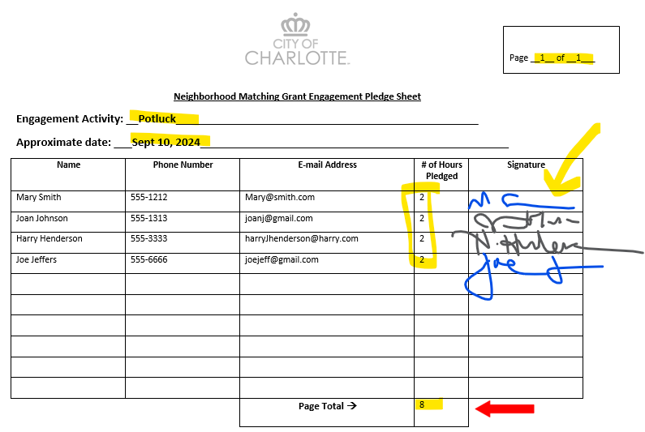
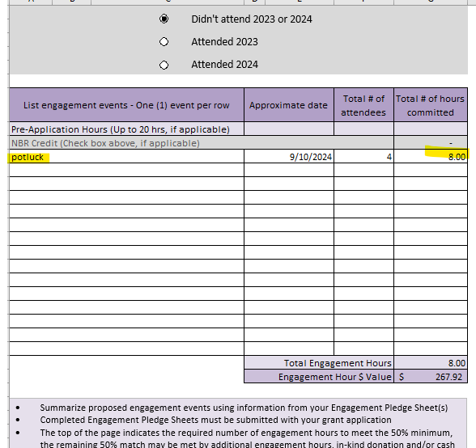
Notes:
In this final section, we’ll discuss the required documentation:
- pledge sheets and sign in sheets – and the difference between them, and the
- budget worksheet
And optional documents, including the contribution template
Let’s start with pledge sheets. You will be asked to submit volunteer hour commitments with your application. Pledges for volunteer engagement must be a minimum of 50% of your grant request. You may match funds with 100% volunteer engagement, or once the 50% requirement is met, you may use any combination of hours, inkind donations of goods or services and cash contributions to meet the second half of the match.
When planning your events, think about events you already do or things you want to try! You’ll be asking your neighbors and other volunteers to commit hours to show support for the project. Hours can be in the form of project implementation or for fun activities like National Night Out. You might secure all of your hours at one specific event, but more than likely, you will have several volunteer events related to the project. Please submit a volunteer pledge sheet for each event.
Neighborhoods are fluid, and individuals move into and out of neighborhoods during projects, so it helps to show commitment from a large number of volunteers.
We are only accepting written pledges going forward. (effective June 1, 2024) The virtual option implemented during the pandemic has ended and we’re going back to basics. Please use this pledge sheet, downloadable from the application.
The total of your pledge sheets need to match up with what you are reporting on the budget-volunteer hour worksheet.
Each activity should have a sheet/s and the total pledge hours for that activity get copied over to the worksheet.
The purpose of the pledge sheets and the goal of this requirement is to show broad support and participation from your neighbors. Those pledge sheets contribute toward your Participation score.

Slide 3
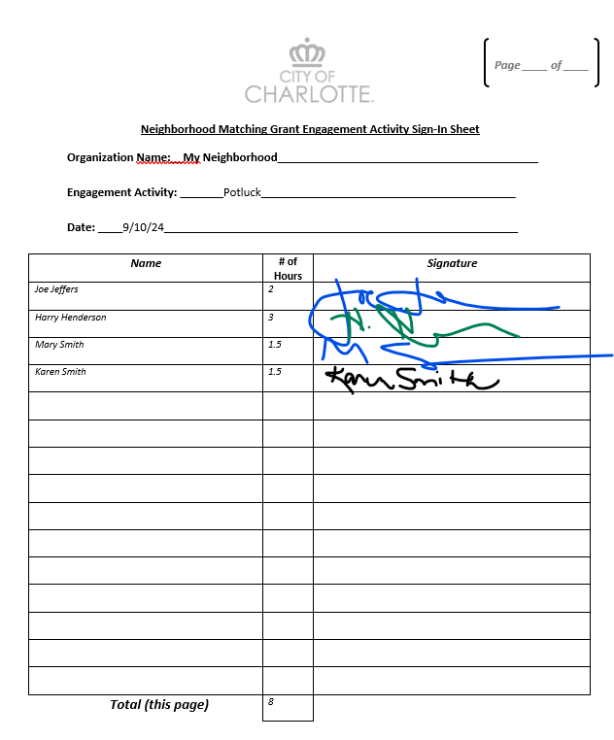
Notes:
The document on your screen now is the Sign in sheet – this is the sheet you’ll print to take with you to your events.
This needs to be signed by the event participants – no virtual sheets will be accepted (effective June 1, 2024 application cycle)

Slide 4
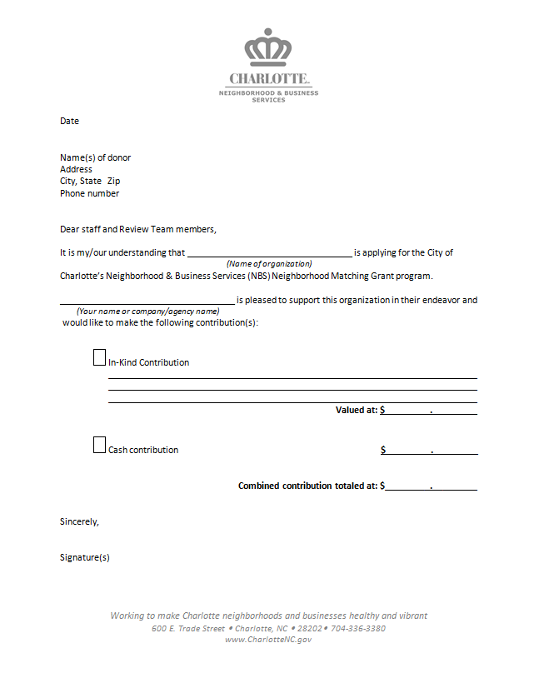
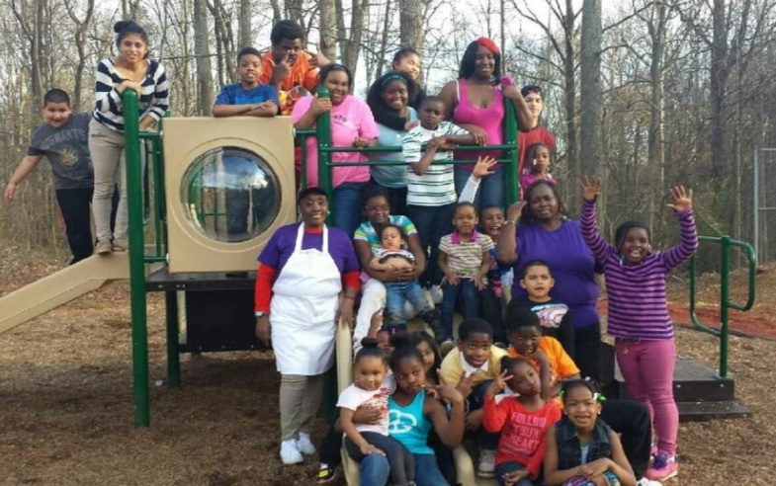
Contribution Template
Optional format for documenting In-Kind and/or Cash Contributions
Standard letter is also sufficient
All NMG Forms available at https://publicinput.com/nmgforms
Pine Valley Community Organization, Playground
Notes:
You will also be asked to document any cash or in-kind contributions that individuals or organizations will put toward the project. For every cash or in-kind contribution listed on your budget worksheet, you will need to submit a contribution template or other written documentation. These might be from your neighborhood organization, individual residents, or local businesses.

Slide 5
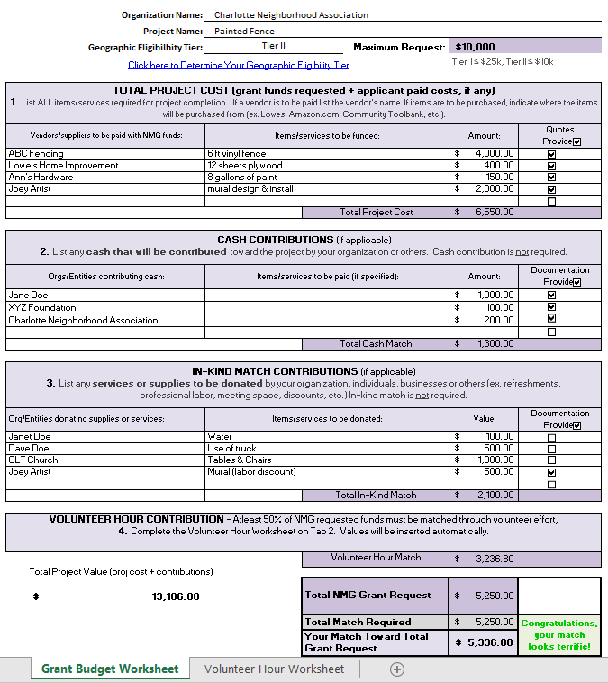
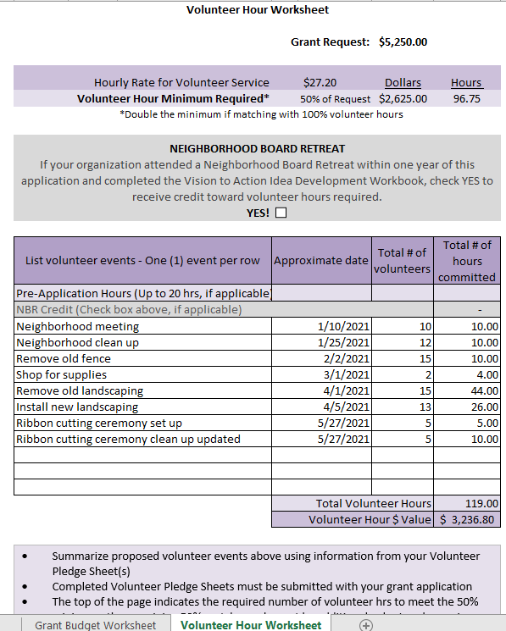
Budget Worksheet
Tab 1 – Grant Budget Worksheet
Tab 2 – Volunteer Hour Worksheet
Notes:
The budget worksheet is one of the most important pieces of your application. The budget worksheet template helps your neighborhood think through the necessary expenses, funding sources, and volunteer commitments required to complete your project.
The budget worksheet is a Microsoft Excel spreadsheet. The first tab asks you to list project costs, both those for which you are requesting funding, and those which your neighborhood will cover. It also asks for any in-kind contributions that your neighborhood anticipates. In-kind contributions can come from residents, local businesses, community partners, or other sources.
Based on the figures you input on the first tab, the second tab will show the minimum number of volunteer hours your neighborhood needs to commit to. On this page, you should list volunteer activities and projects hours. Once these numbers are entered, the first tab will update to reflect the value of your volunteer commitment.

Slide 6
What’s Next if your Project is Approved?
Complete Vendor Registration in City’s system
Begin volunteer engagement activities
Attend contract signing & grant orientation
After contract signing:
Begin project purchasing & implementation
Submit receipts/invoices to City for reimbursement (allow 8-12 weeks for contract execution and up to 30 days for payment processing)
Submit Bi-Monthly Summary Reports
Grant completion & closeout

Slide 7
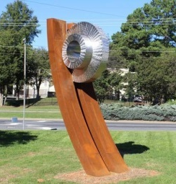
SUCCESSFUL PROJECTS
AND IDEAS

Slide 8
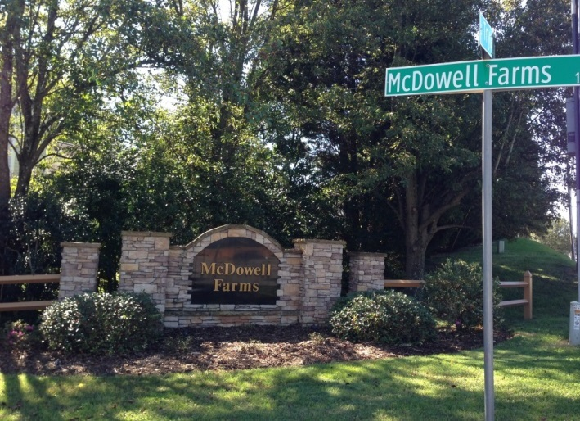
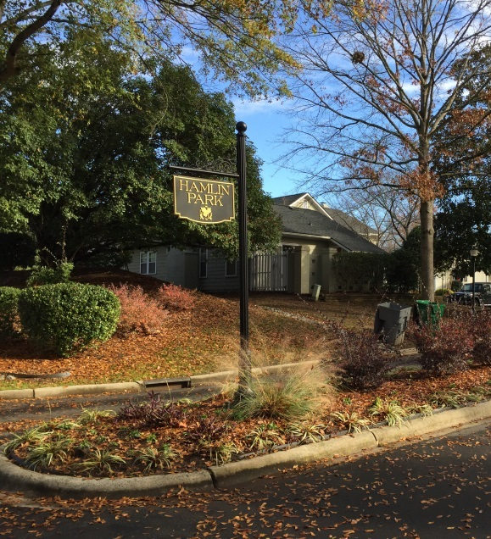
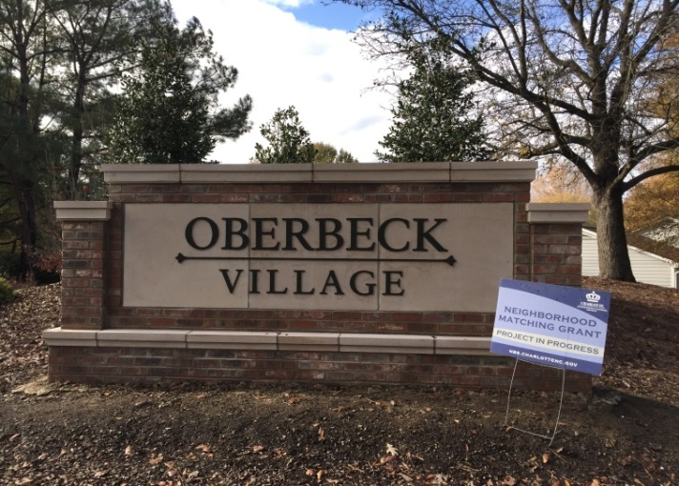
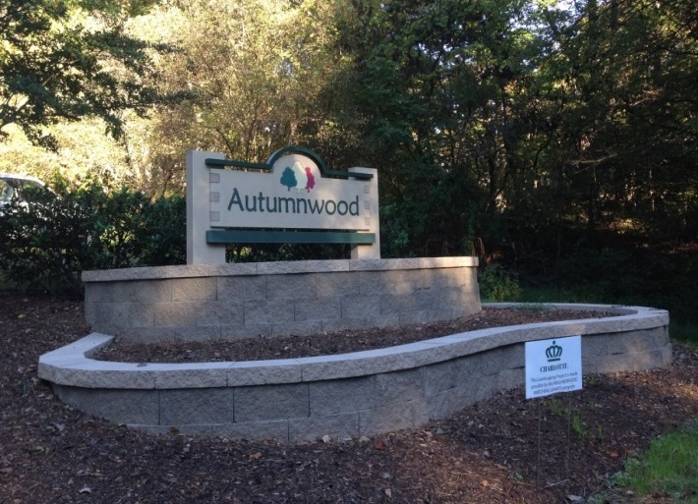
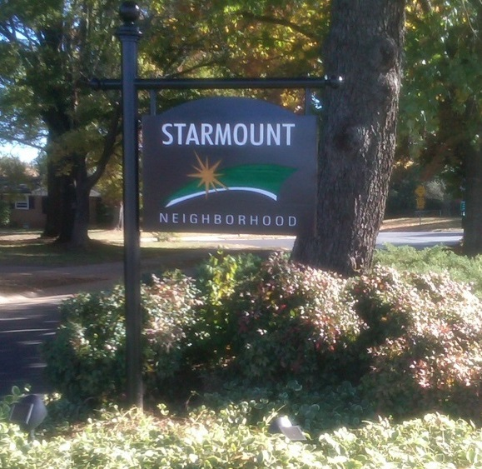
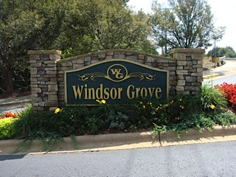
Featured Successes – Entrance Signage
McDowell Farms Neighborhood Association
Oberbeck Village Home Owners Association
Hamlin Park
Autumnwood Community
Starmount
Windsor Grove Homeowners Association
Notes:
We love to share success stories! Many neighborhoods have received matching grant funds for entrance signs, as seen in these pictures...

Slide 9
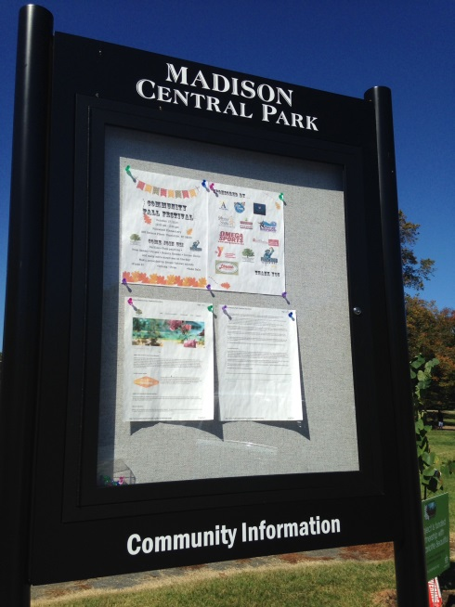
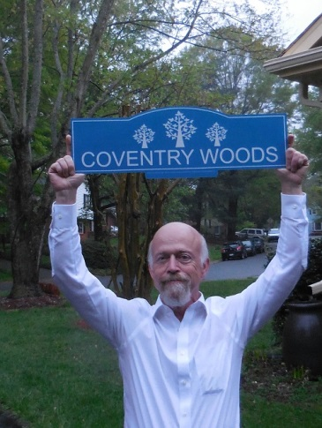
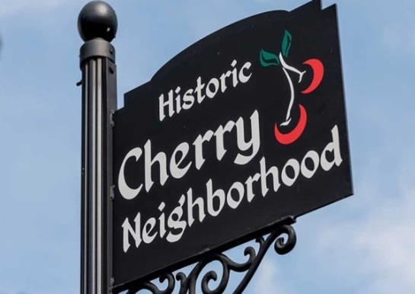
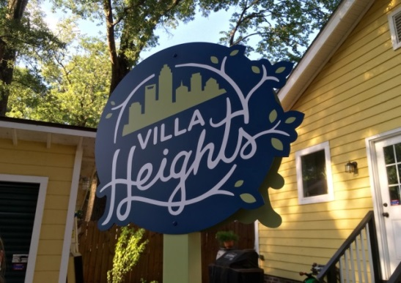
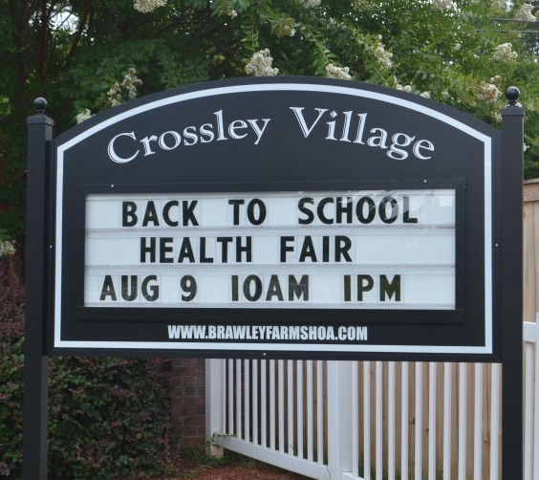
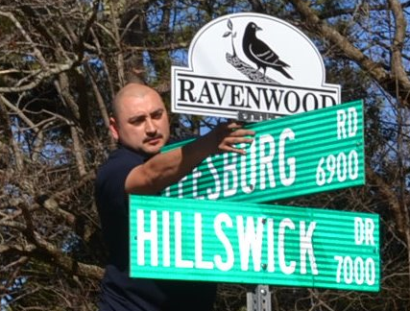
Featured Successes – Toppers & Info Signs
Cherry Neighborhood Association
Madison Park
Coventry Woods
Villa Heights Community Organization
Ravenwood Neighborhood Association
Brawley Farms, Crossley Village
Notes:
Other neighborhoods have received funding for decorative pole signs…

Slide 10
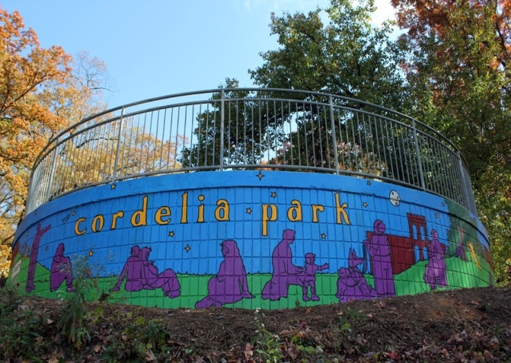
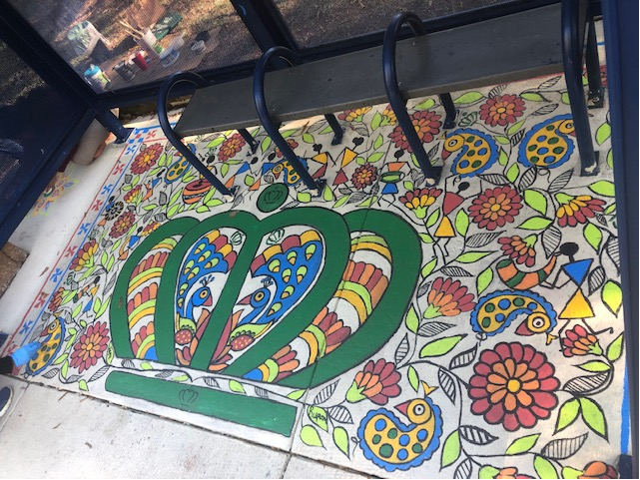
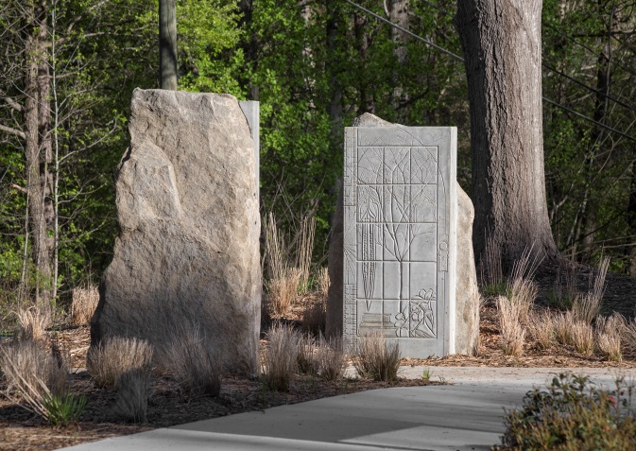
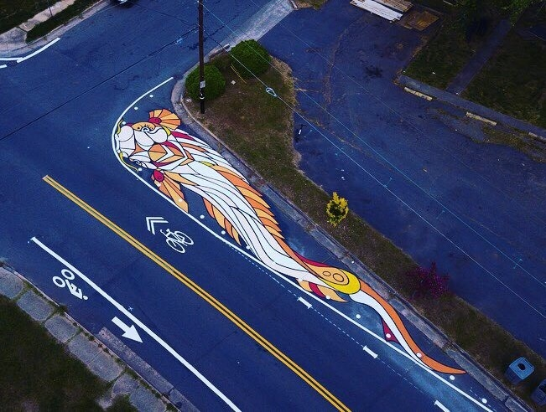
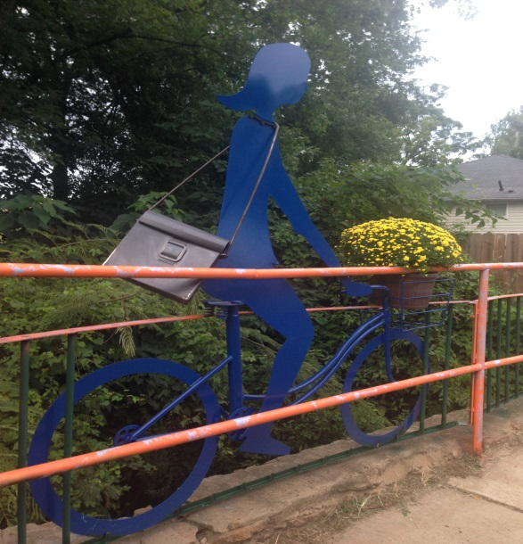
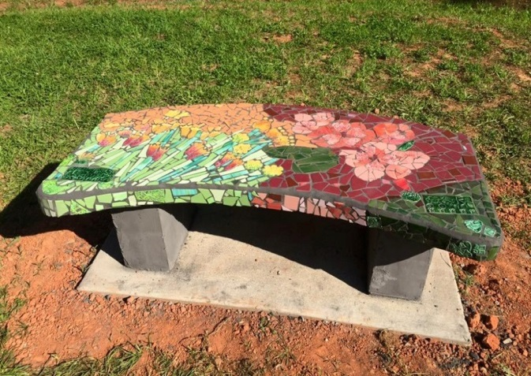
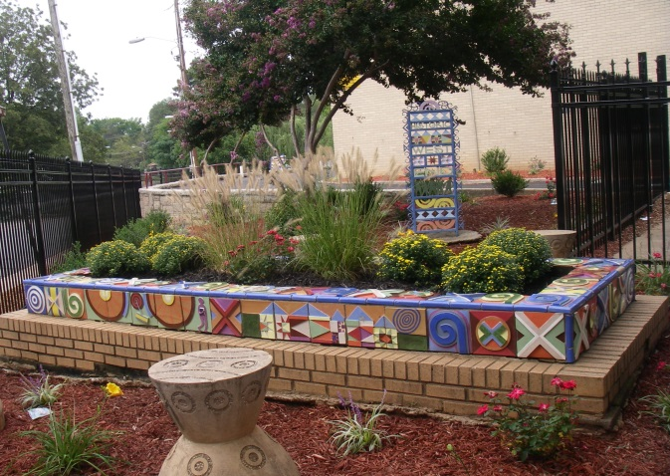
Featured Successes – Art & Beautification
Villa Heights Community Organization
West Bv CATS Bus Stop
Plaza Midwood Open Streets 704
Grove Park Neighborhood Association
Historic North Charlotte (NoDa)
Historic West End
Notes:
Many neighborhoods have received grant funds for public art projects including murals…

Slide 11
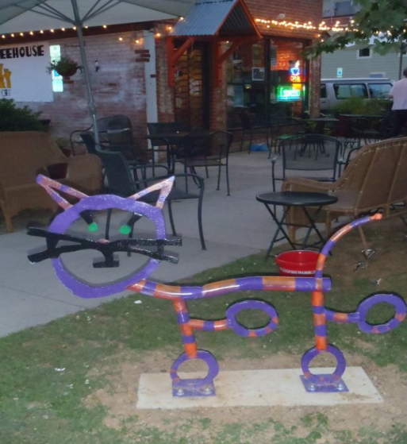
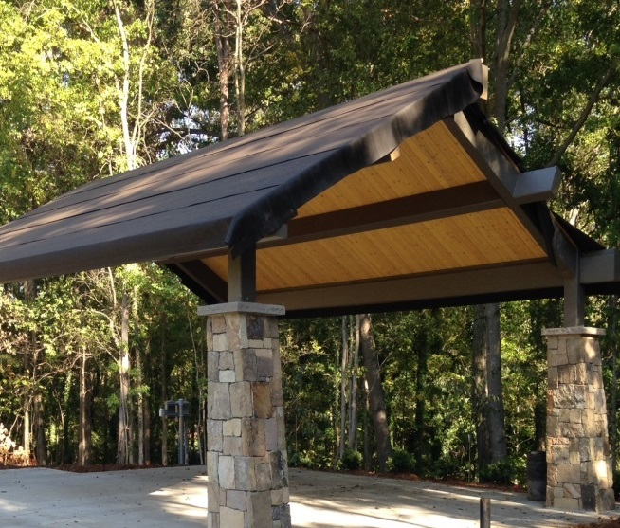
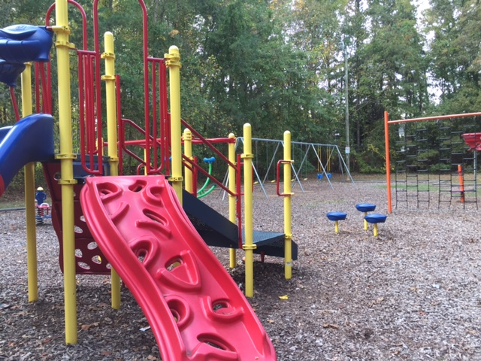
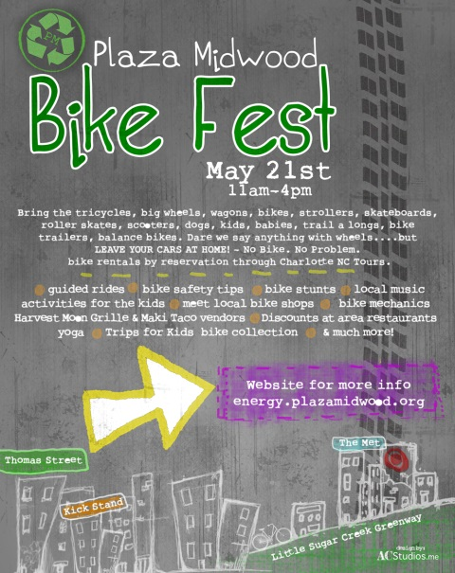
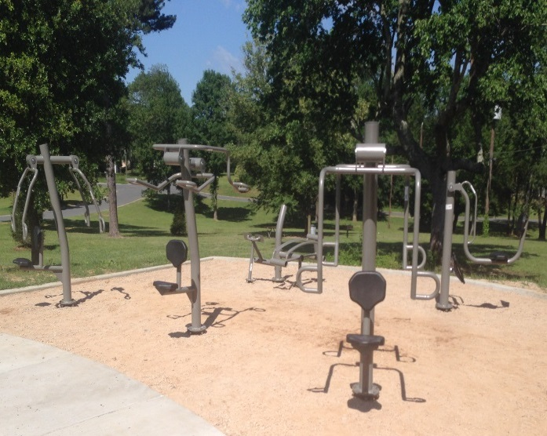
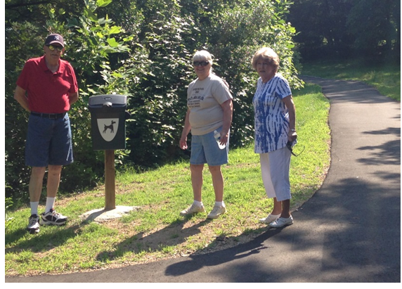
Featured Successes – Recreation
NoDa, Bike Racks
Reid Park, Cathedral Park Pavilion
Stonington HOA, Playground
Druid Hills, Fit Park
Plaza Midwood, Bike Festival
Hampton Park, Community Trails
Notes:
And to create or improve nature trails!

Slide 12
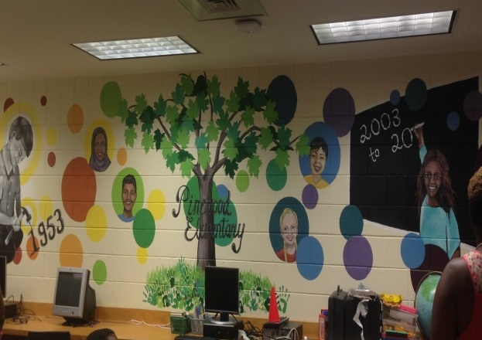
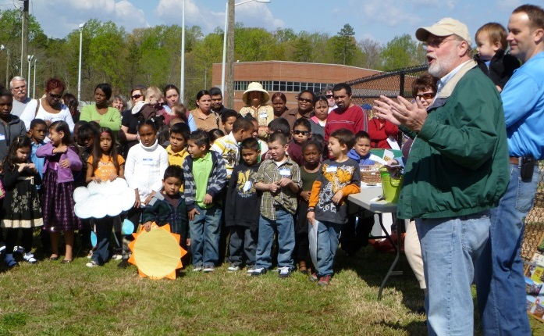
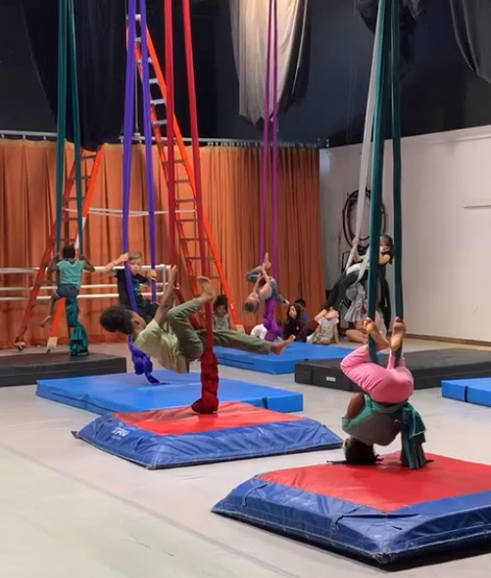
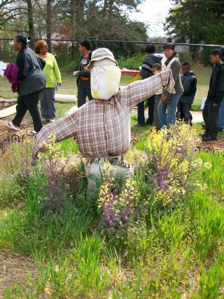
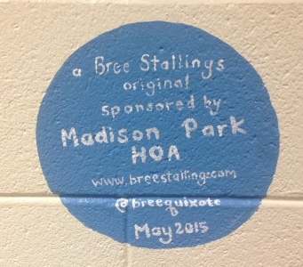
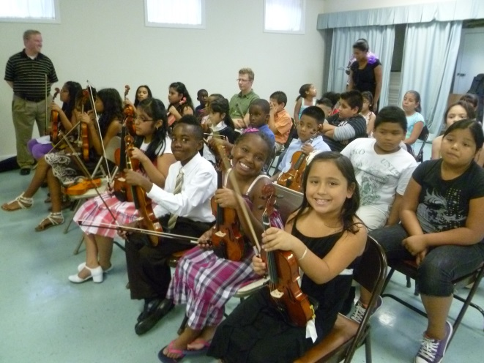
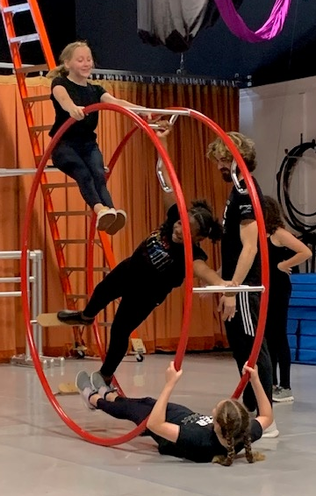
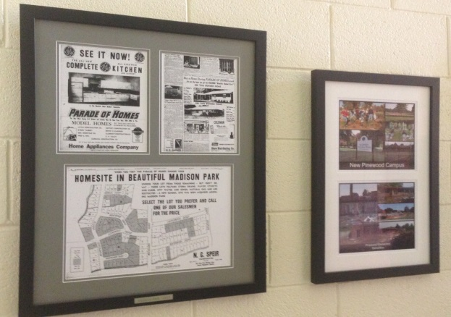
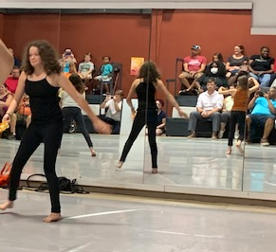
Featured Successes – Partnerships
Madison Park Homeowner’s Association &
Pinewood Elementary, History Wall
Winterfield Neighborhood Assoc & Winterfield Elementary, Student Symphony & Community Garden
Monroe Road Advocates (MoRA), Greenway Park Elementary and Charlotte Cirque & Dance Center
Notes:
Neighborhood organizations have partnered with schools on matching grant projects.
Partnerships are a win-win for the neighborhood and the school.

Slide 13
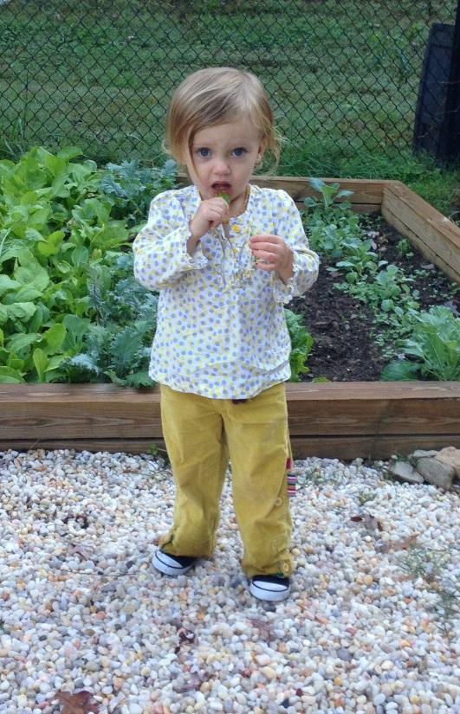
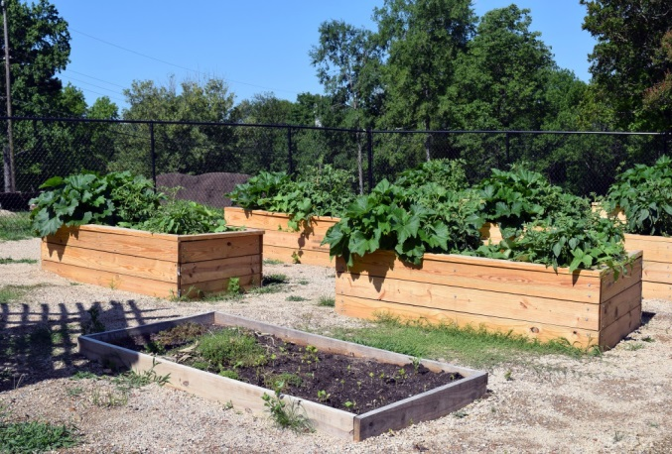
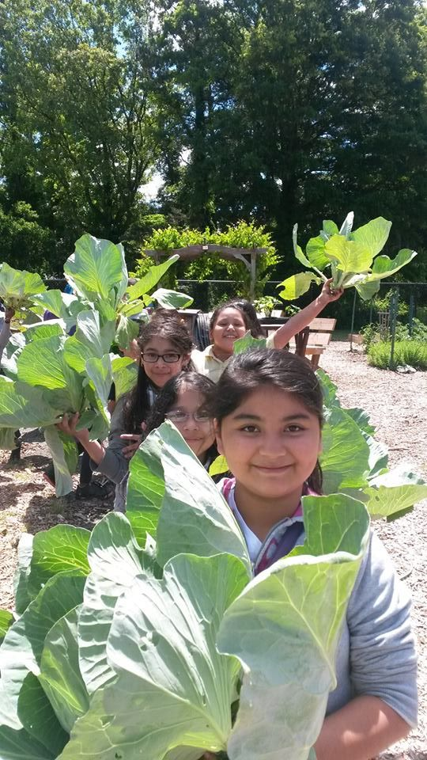
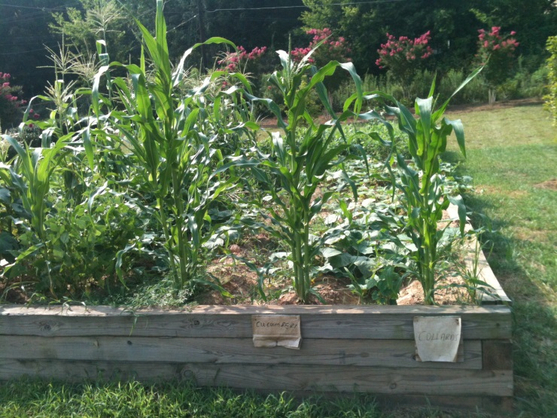
Featured Successes – Community Gardens
Druid Hills
Villa Heights
Washington Heights
Winterfield
Notes:
Many neighborhoods across Charlotte have started community gardens with the help of a neighborhood matching grant.

Slide 14
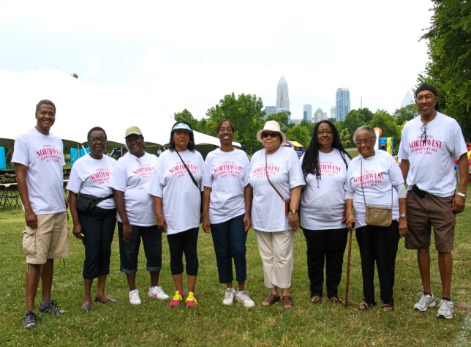
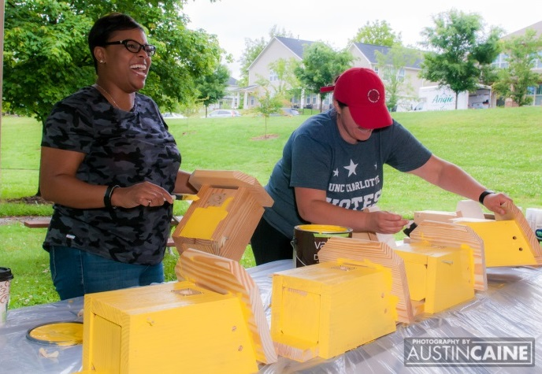
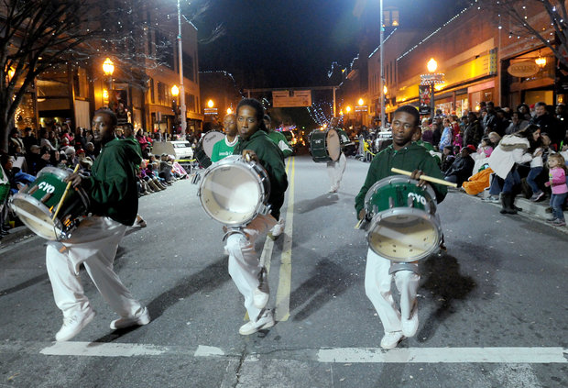
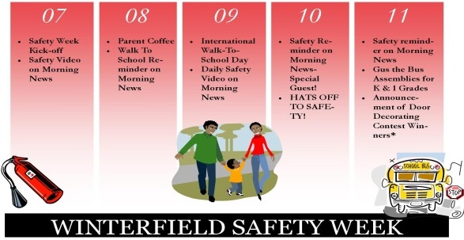




More Featured Projects
Northwest Community Day, T-shirts
Anita Stroud Park, Birdhouses
Greenville, Heritage Festival
Hidden Valley, National Night Out
Brightwalk, No Barriers
Oaklawn Park, Little Free Library
CCCP Amplify the Signal
Notes:
Remember – the projects we have highlighted are only examples of what grant funding can be used for – we encourage you to think of a project that will have the greatest impact for your community.
So… what will your neighborhood think of next?

Slide 15




Project Ideas
Community Asset mapping Membership drives Printing/mailing Yard signs (meeting date, yard or volunteer of the month, etc) Strategic planning Non-profit registration | Nuisance prevention Cultural programs Health and wellness Senior programs Language programs Computer training/Digital Literacy Little Free Library /Food Pantry | Park enhancements Playground/fitpark equipment Athletic fields Trails Bike racks Outdoor chess/checkers/games Stages/performance space | Infrastructure improvements Community centers Mailboxes Trash receptacles Dumpster enclosures Decorative fencing Curb Appeal improvements* * Curb appeal improvements and maintenance items permitted only in Tier 1
Notes:
The next few slides include project ideas and opportunities.

Slide 16






Project Opportunities
 | Water, energy & waste reduction initiatives Recycling campaigns Transit stop amenities Bike Racks Waste receptacles-pet, recycling, cigarette butts, gum |  | Sign toppers Neighborhood Identification Entrance monuments Event signage & banners Way finding signage Garden signs Can do signs
 | Community gardens Ozone garden Greenhouses/hoop houses Butterfly gardens Training & education Community cookbook |  | Logo/brand development Website development Brochures/marketing collateral T-shirts, pens, stickers, magnets Neighborhood directory
 | Curb appeal improvements Street adoption Community/vacant lot clean-up Landscaping Stream clean-up |  | Street lights Traffic Calming Security fences Security cameras Neighborhood Watch group Crime watch signs
Safety & Security
Notes:
We see it as a compliment to the great work underway for us to widely demonstrate what’s possible.

Slide 17


What Will You Do?
 | Landscaping Trail improvements Water fountains Murals Benches Decorative Planters | Community art Decorative signal cabinets Birdhouses Artistic railings Lighting improvements Tree planting
 | National Night Out Back to school events Music/art festivals Neighborhood meet & greet Cultural festivals Community reunion | Community cares day Home tour Holiday celebration Neighborhood history walk Community day 5k walk/run
 | Improved quality of life Increased property values New friends Community happiness | Civic pride Problems turned opportunities Neighborhood dreams come true What will you do?
Projects are not required to have been done before – reach out if you want to discuss an idea not shown.
Art & Beautification
Festivals & Special Events
Your Project Here
Notes:
And we hope that seeing what others have done is beneficial and maybe provide ideas or inspiration for your own projects!

Slide 18

More Information
NMG Website
https://www.charlottenc.gov/Streets-and-Neighborhoods/Get-Involved/Neighborhood-Matching-Grants
Sign-In Sheets, Current Guidelines
and Other Documents
https://publicinput.com/nmgforms
Questions:
Jackie Clare Community Grants Program Manager | Maddi Meade Watson Neighborhood Programs Support Specialist
jackie.clare@charlottenc.gov 980-214-3540 | madison.meade@charlottenc.gov 980-416-7035
Notes:
Here are ways to get more information and contact info for program staff.
Thanks for participating in this virtual workshop!

