Slide 1







Mobility
For Transit and Transportation
“Per state statutes, city staff are not permitted to advocate for or against any measure or candidate. Staff may provide informational content to help the public understand official processes, services, and decisions. Any information shared by City staff is for educational and informational purposes and should not be interpreted as an endorsement or opposition.”

Slide 2

A voter referendum will allow Mecklenburg County residents to approve or deny a one-cent, county-wide sales tax to fund investment and improvements in transit and transportation.
Visitors
Outside County
Sales Tax Excludes:
Most foods/grocery
Housing
Medicine
Medical Services
Electricity
Gas
Telephone
$5.8B
30%
70%
Additional $5.9B from Federal Grants and Other Funding
Residents & Businesses
In the County
$13.6B
Source: Charlotte Regional Business Alliance 2022 Tax Study
2
Notes:
30% comes from outside the County

Slide 3
How would the money be spent?
Investing in All the Ways We Get Around
$19.4B
One Cent - Mecklenburg County Sales Tax
30-year Revenue
(based on current tax revenue projections)
Transportation & Transit
+
+
Roads
Bus & Microtransit
Rail
40%
20%
40%
$138M
$69M
$138M
Year 1
Year 1
Year 1
$7.8B
$3.8B
$7.8B
30 Years
30 Years
30 Years
3
Notes:
We need to invest in all of our transportation needs.
And every neighborhood will benefit from something in this plan... Sidewalks, streetlighting, microtransit, or rail, etc.

Slide 4
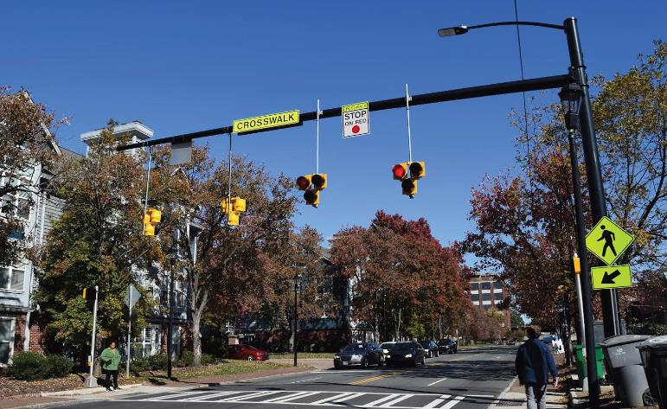
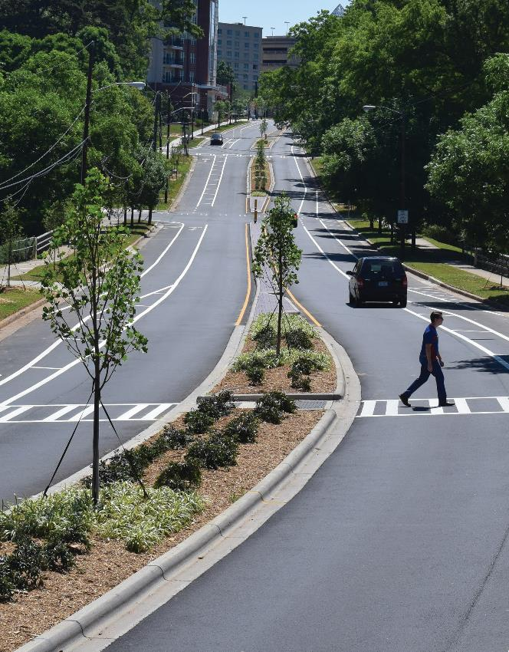
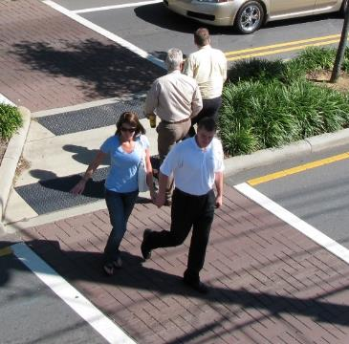
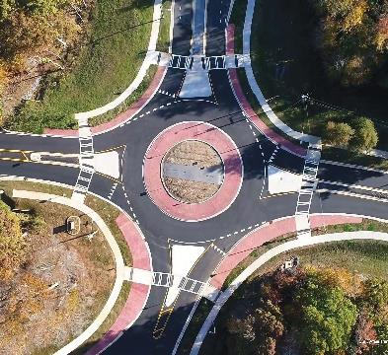
What’s in the Plan
Roads
Sidewalks
Pedestrian Crossings
Streetscape
Intersection Improvements
Road Capacity
New Streets
Street Lighting
4
Notes:
Investment in Roads means: sidewalks, pedestrian crossings, streetscapes, street lighting, etc.
This investment will grow business and job opportunities at all scales and skill levels creating pathways for career advancement and business expansion.
We will need concrete crews, electricians, foremen, construction managers, paving contractors and roadway construction contractors.... Just to name a few.

Slide 5
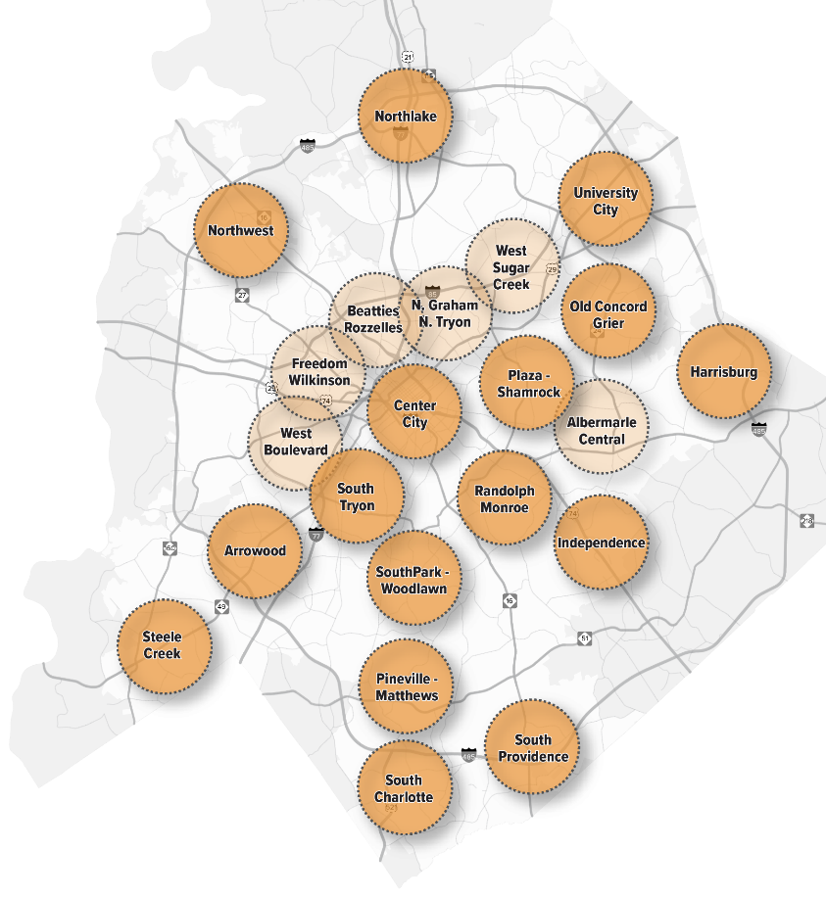
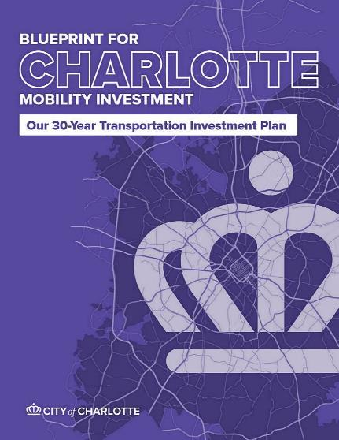
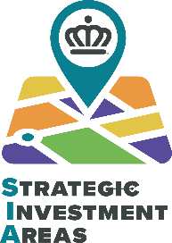
What’s in the Plan
Roads
City of Charlotte
$102M
Year 1
$5.7B
30 Years
*The City of Charlotte and Mecklenburg County have a Letter of Intent for the City of Charlotte to use a portion of its sales tax roadway funds to address orphan roads in Charlotte’s ETJ.
5
Notes:
Strategic Investment Areas identify transportation projects tailored to the uniqueness of every part of our city.
The SIAs are Neighborhood and corridor specific - Beatties Ford has different needs than Harrisburg Road.

Slide 6
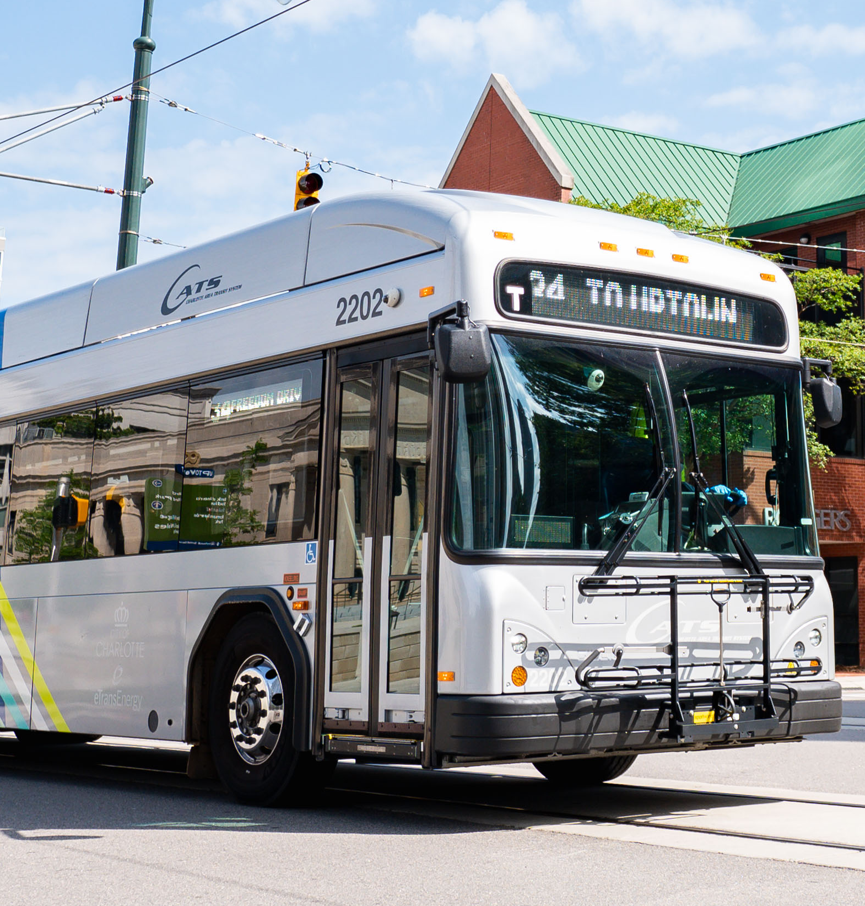
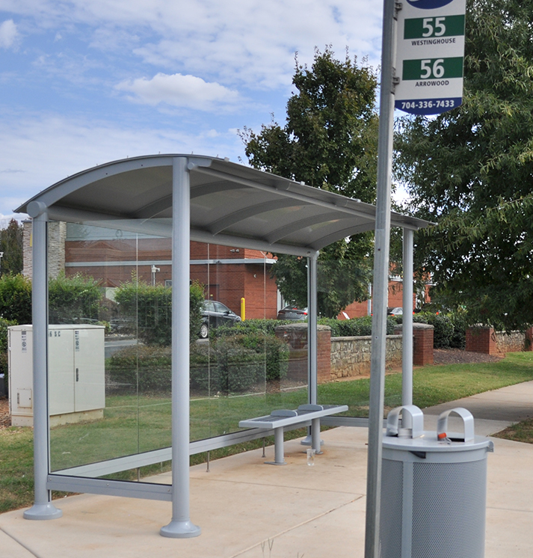
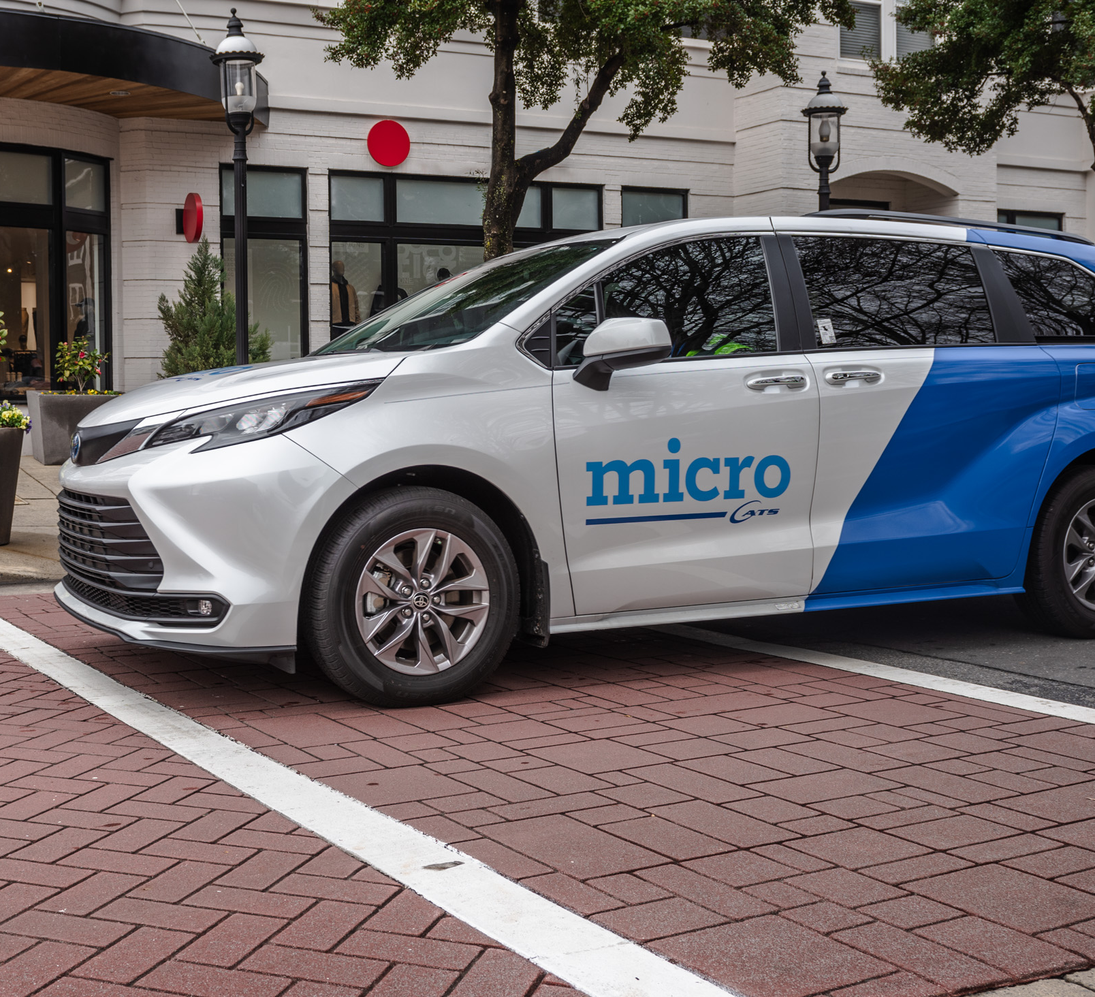
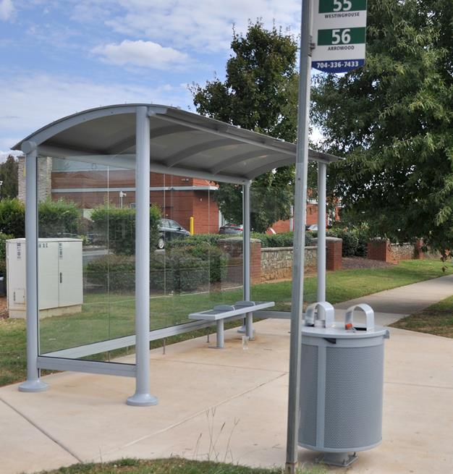
What’s in the Plan
Bus & Microtransit
All Routes Improved in
5
Years
Start Now, Complete all in
10 Years
All Zones Operational in
5
Years
15 for 60
60% of riders get 15-min service
2,000+
Enhanced Bus Stops
Microtransit
Curb-to-curb & On-demand
6
Notes:
Even our investment in the bus system will expand business and job opportunities.
That includes over 200 new bus operators and more microtransit service providers to cover 19 zones and over 100 sq. miles of service area!
And we can do this fast!
All bus route improvements and microtranst zones will start immediately and be fully operational in 5 years.

Slide 7
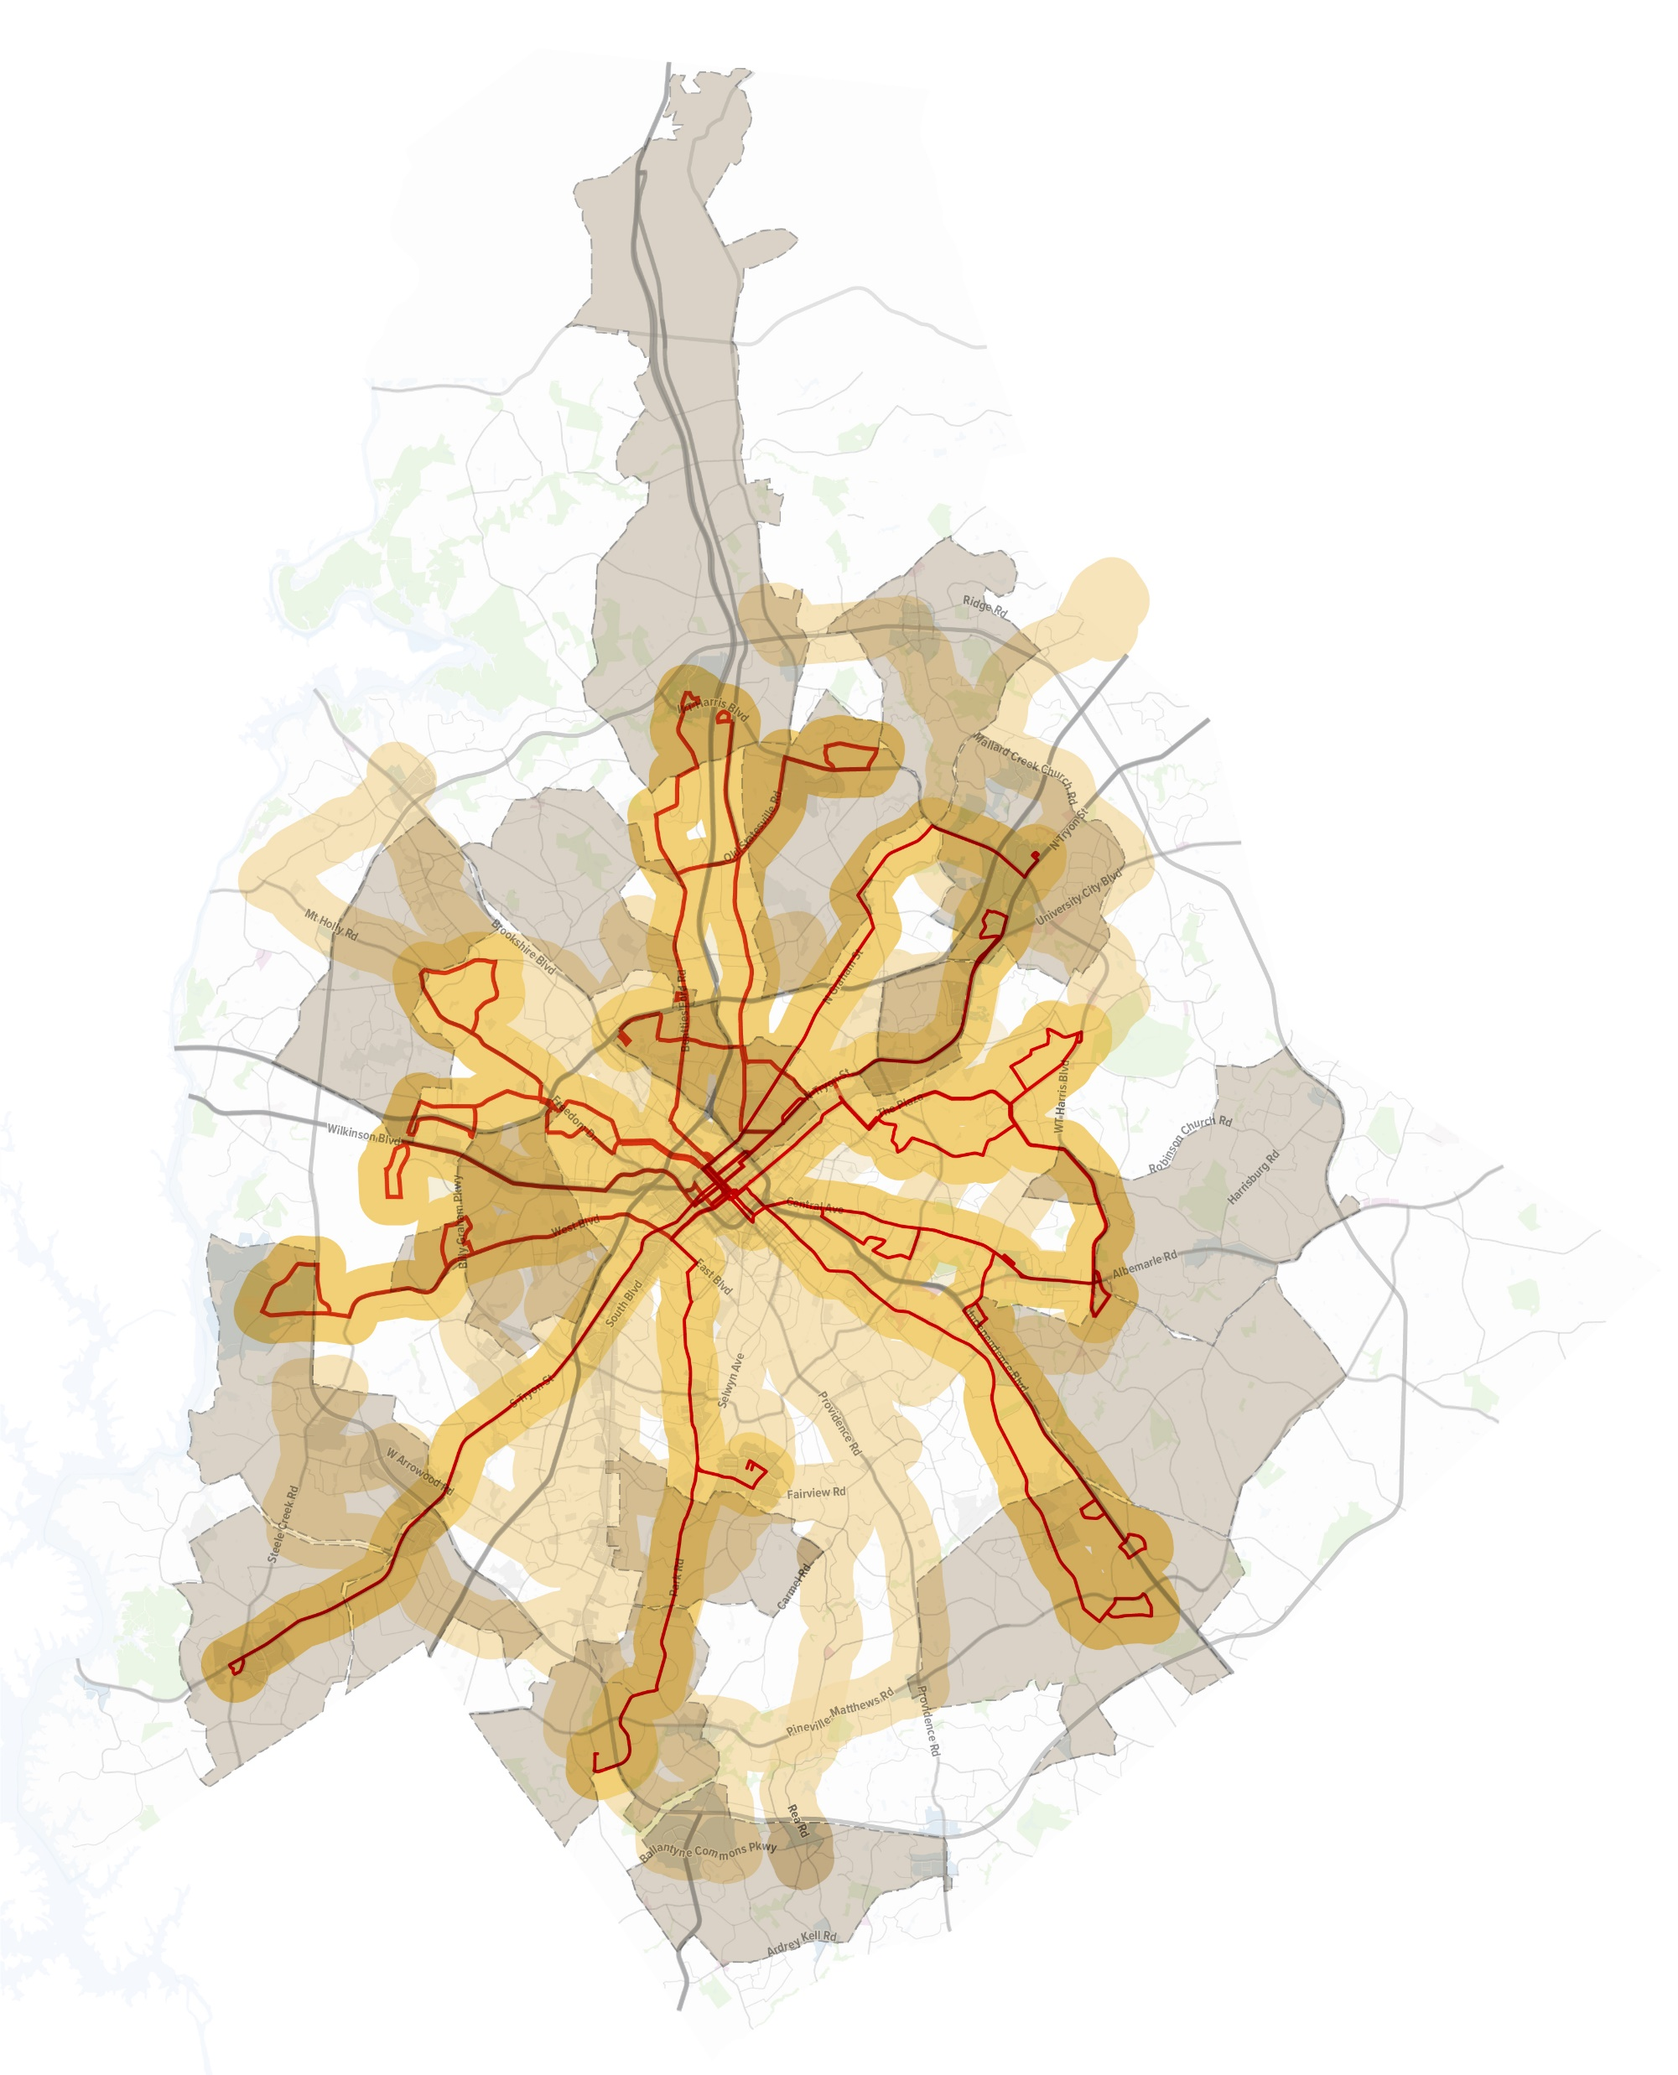
What’s in the Plan
Bus & Microtransit
Better Bus
Better Bus
15-min Frequency on the top 15 routes
30-min Frequency on all routes
Expanded hours on weekdays and weekends
Microtransit in 100 square miles of new areas
15 Minute Frequency Bus Corridors
(10-minute walk)
Microtransit Zones
(on-demand, curb to curb service)
30 Minute Frequency Bus Corridors
(10-minute walk)
Connecting
450K people
to
450K jobs
Within a walk of 15-minute service
(10 min. 1/2-mile walk)
7
Notes:
The reach of the proposed bus plan is beyond anything Charlotte has seen before.

Slide 8
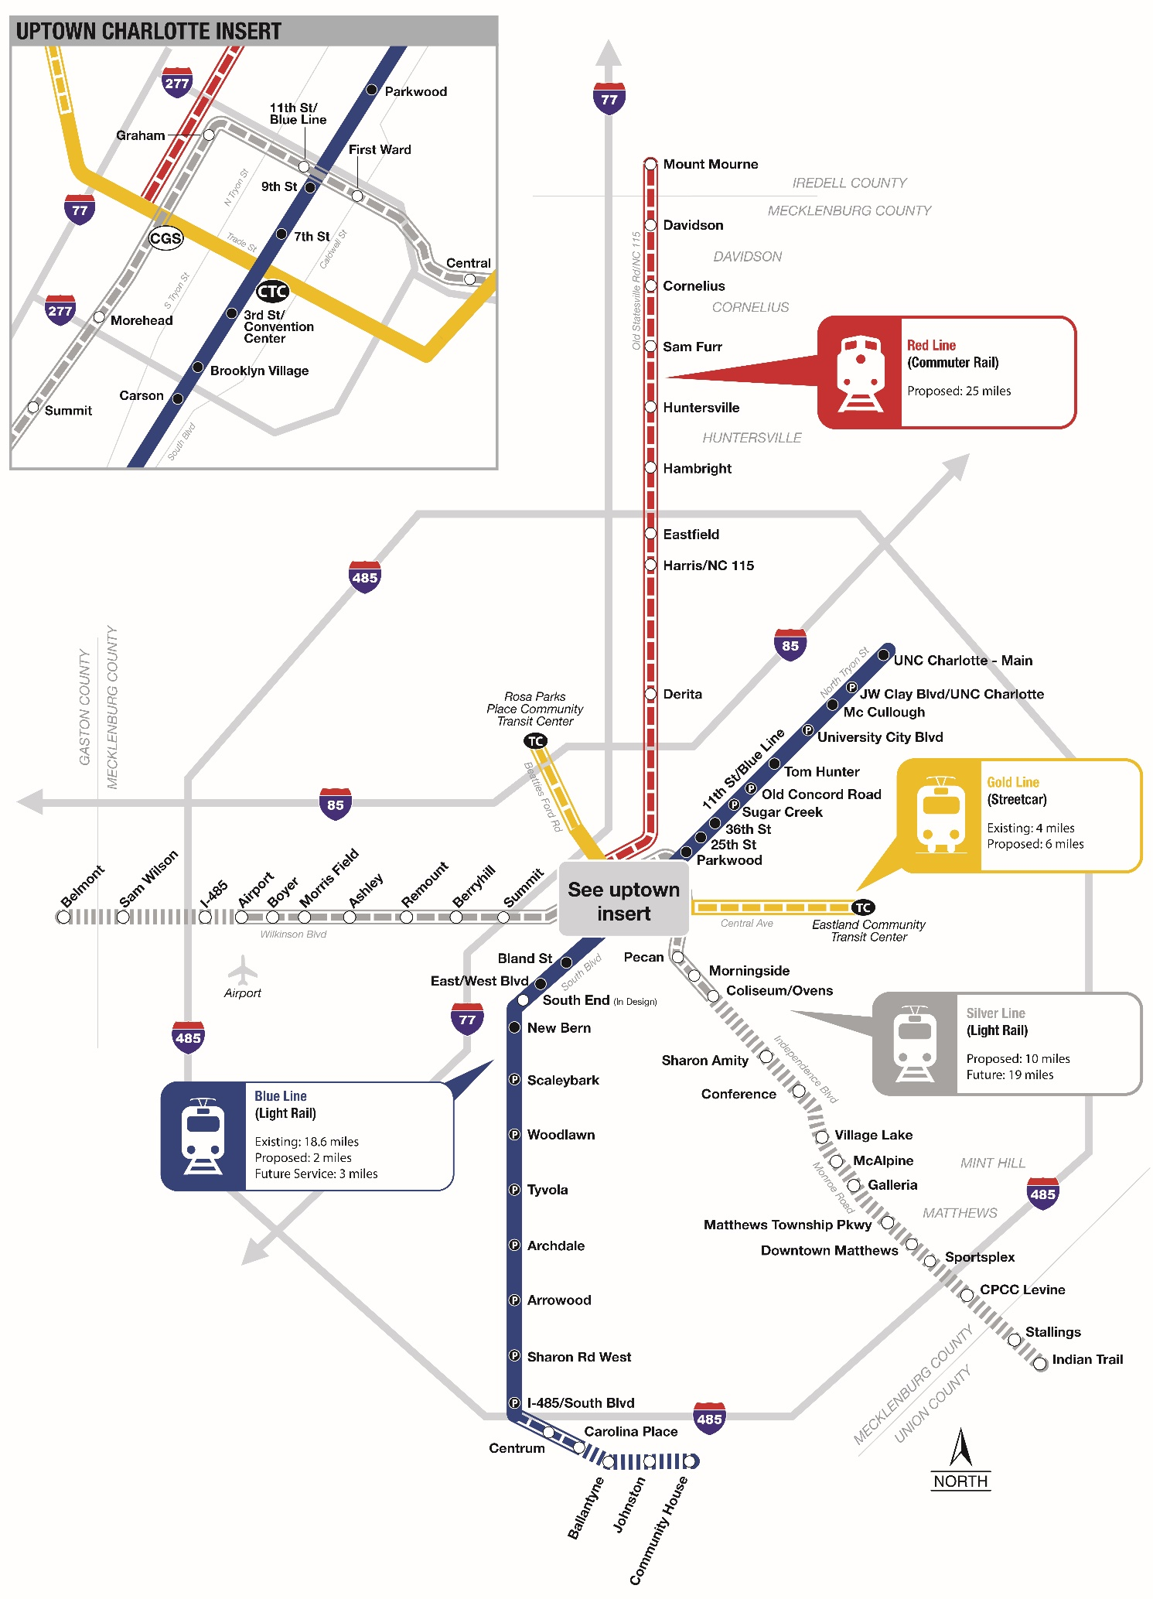
What’s in the Plan
Rail
Transit System Plan
Adopted by
The Metropolitan Transit Commission (MTC):
May 28, 2025
Red Line
Charlotte Gateway Station to Mooresville/Iredell County
For the portion of the Red Line in Iredell County, the financial analysis assumes a future local funding match; source(s) to be determined.
Gold Line
Extension
Rosa Parks Place to Eastland
Silver Line
Airport to Coliseum/Ovens
Blue Line
Extension
I-485 to Carolina Place/Pineville
Future Silver Line Extension to CPCC Levine
Future Blue Line Extension to Ballantyne
8
Notes:
We get Gold Line East and West.
We get multiple Red Line stations.
We get Silver Line from the Airport to Uptown to Bojangles.

Slide 9
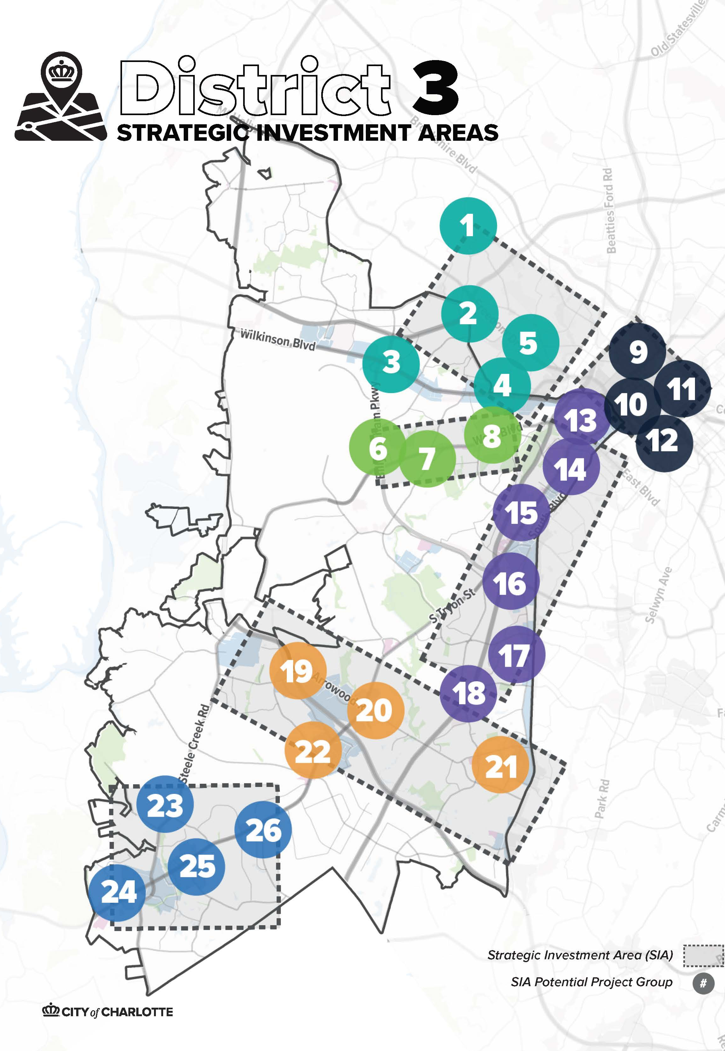
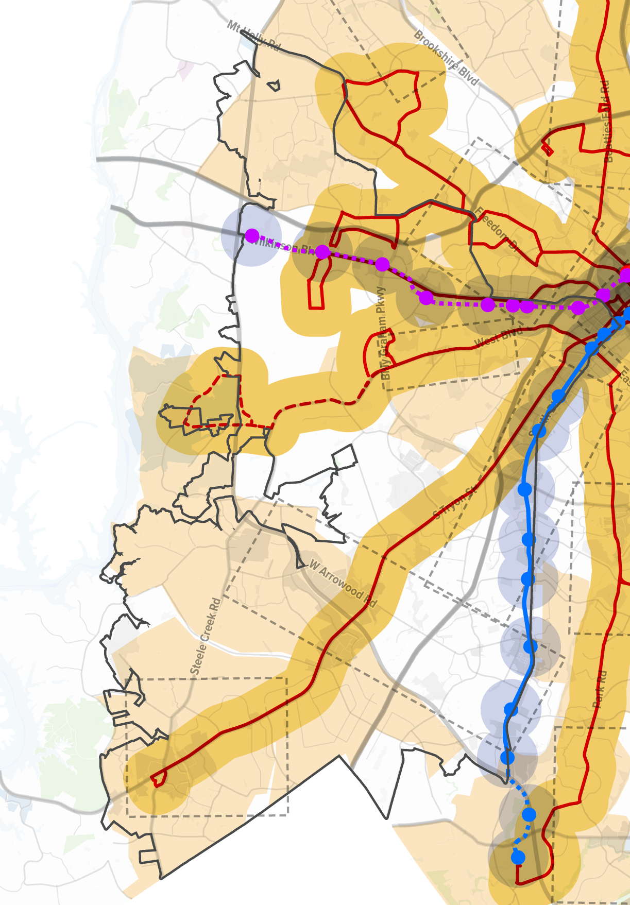
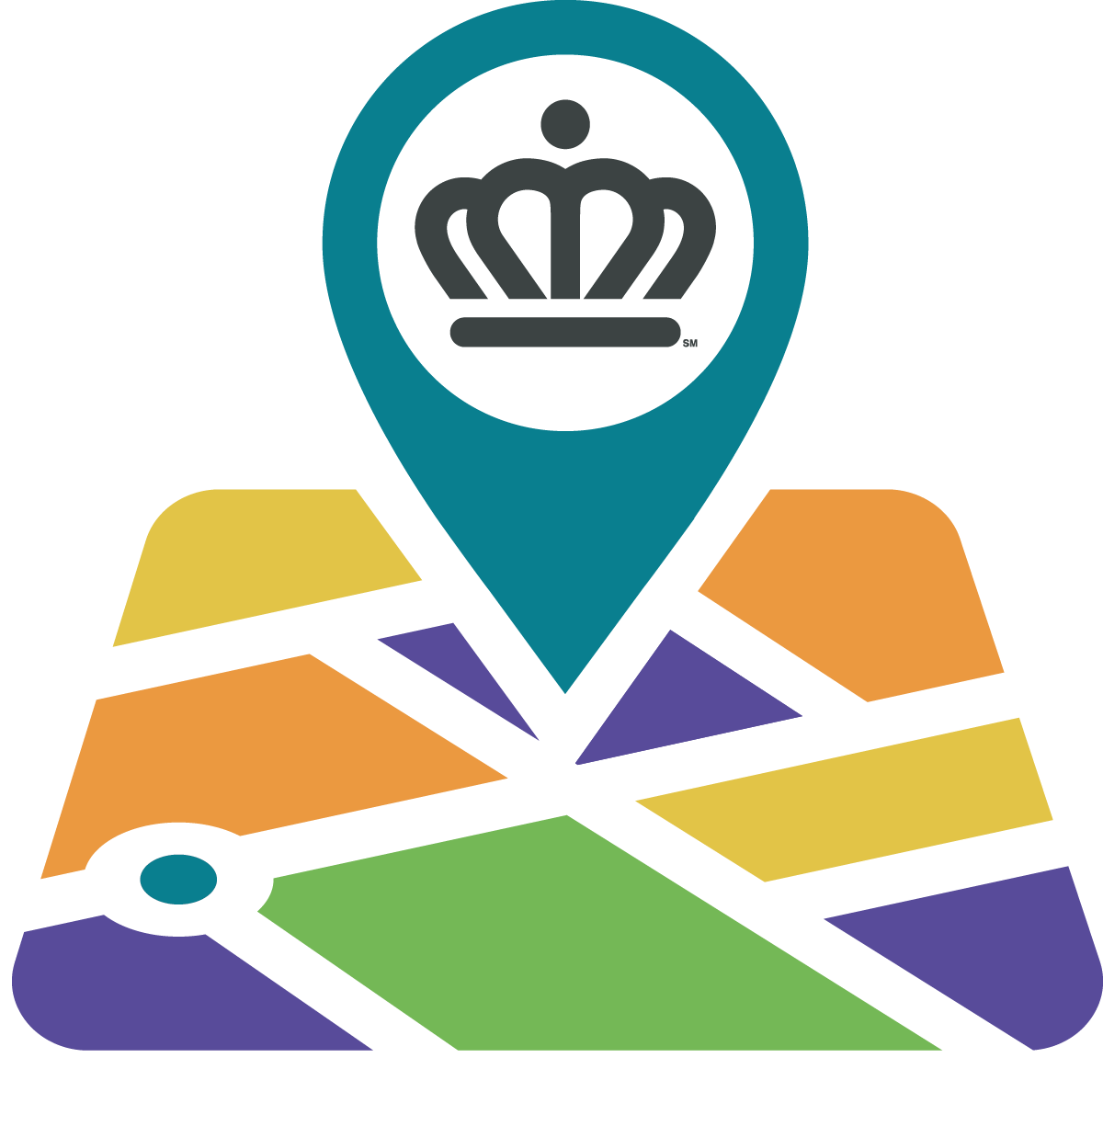
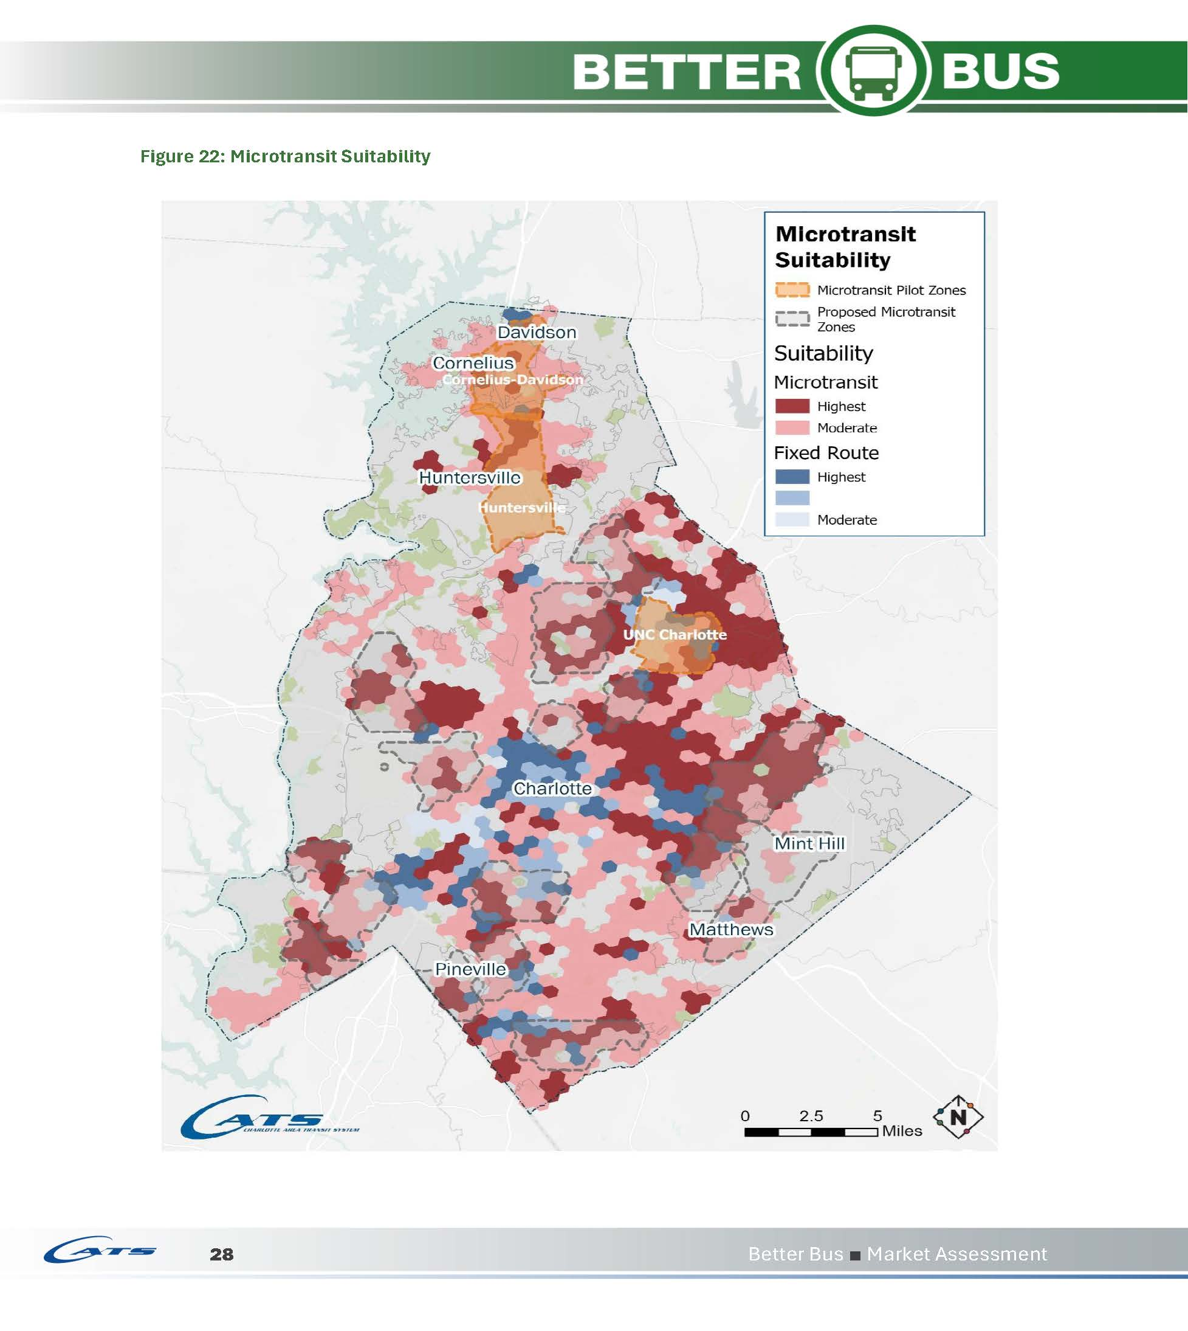

CATS
Transit System Plan Update
Sidewalks & Complete Street
Intersection Improvements
Road Capacity
New Streets
Street Lighting
15-minute Bus Corridors
Freedom Wilkinson
West Boulevard
Charlotte Douglas Airport
River District
Silver Line
(Uptown to Airport)
Arrowood
South Tryon
Microtransit
Blue Line
(Extension to Pineville)
Rivergate
Steele Creek
Pineville

Slide 10
Strategic Investment Areas (SIA) Program
Program overview

Slide 11


Pilot Program Timeline and Funding
Identify, design, and construct mobility projects - $55M
Develop a Program Implementation Plan outlining an express delivery process
Identify, design, & construct projects in 2 Strategic Investment Areas
Blueprint
Notes:
Goal 1. Identify, design, and construct mobility projects for FY25 Program funds. ($55M)
Obj 1) Identify “bundles” of projects in up to 3 Strategic Investment Areas.
Obj 2) Design and construct impactful, quick-win projects (Phase1).
Obj 3) Identify Phase 2 projects that will enhance/build-upon Phase 1 projects.
Goal 2. Develop a Program Implementation Plan outlining an express delivery process.
Obj 1) The program team will administer and implement mobility projects from initiation to construction completion, acting as a one-stop-shop
Obj 2) Outline resource management plan to allow a one-stop-shop delivery.
Obj 3) Establishing monitoring and reporting process to track program success.
Goal 3. Identify, design, and construct projects in 2 SIAs
Obj 1) Identify “bundles” of projects in each SIA to maximize benefit and optimize delivery efficiency.
Obj 2) Harrisburg – Far East
Obj 3) Arrowood
Overall Goal: Deliver a successful pilot Strategic Investment Areas Program that will become the blueprint by which future SIA projects are selected, managed, and delivered.

Slide 12

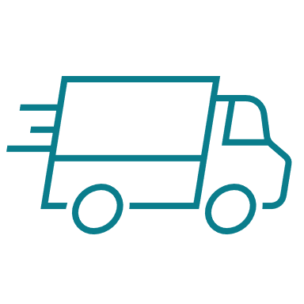

A New Way to Deliver Projects
One City,
One Vision
Express Delivery
Centered Pendulum
Notes:
A cross-departmental approach, where all decisions are made during SME Workshops and submitted to the Strike Team for concurrence. Subject Matter Experts will be empowered to make decisions. Timely involvement and informed decision-making at the SMEs level are a critical component.
Project selection and implementation will be delivered with urgency. The program will act swiftly to select mobility projects that can be advanced quickly and align with our Strategic Mobility Plan. Priority will be given to projects that can be expedited.
The best project isn’t always the perfect project. The best project seeks balance of what we want, need, and can deliver.

Slide 13


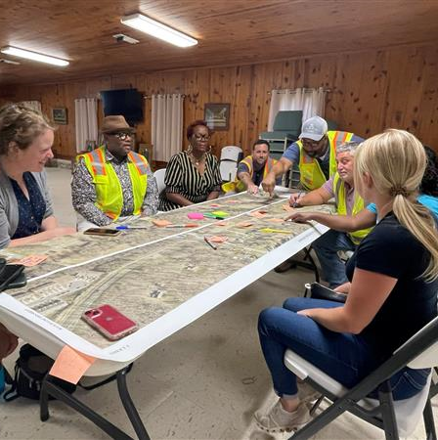
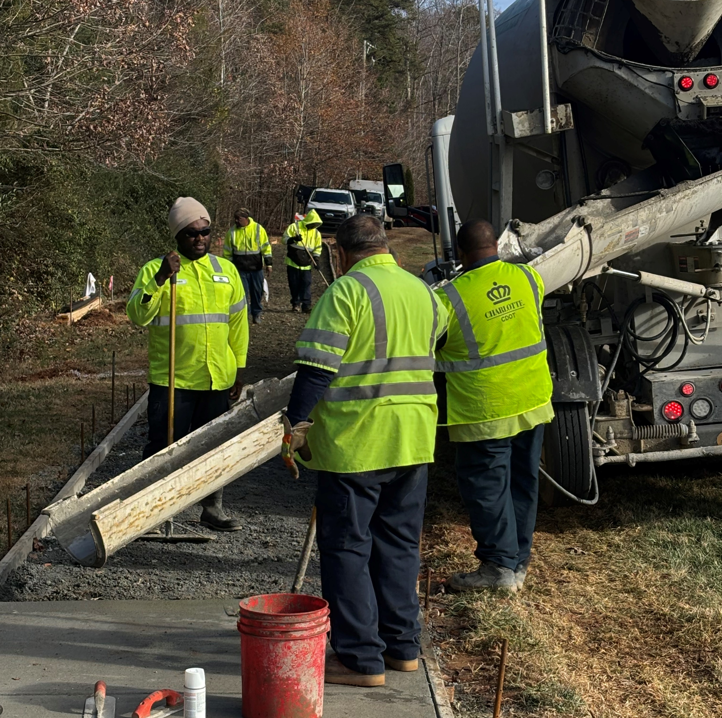

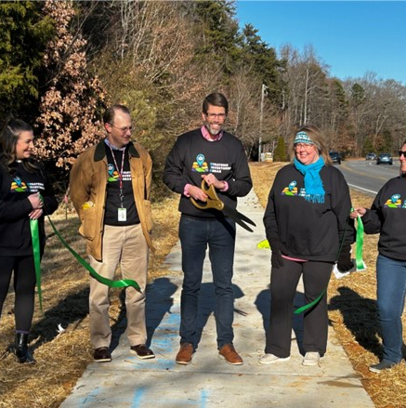
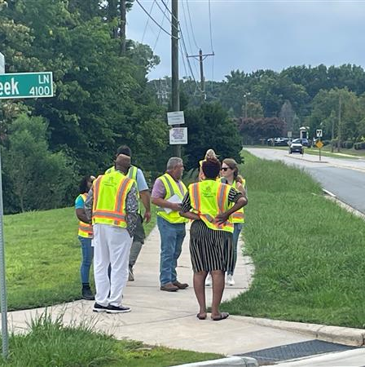


Risk Focused Approach
Review SIA
Construction
Select Projects
Ribbon Cutting
Field Walk
Design
Notes:
ASHLEY - Differences between SIA and previous processes aka what are we doing differently. Risk based approach, etc .

Slide 14
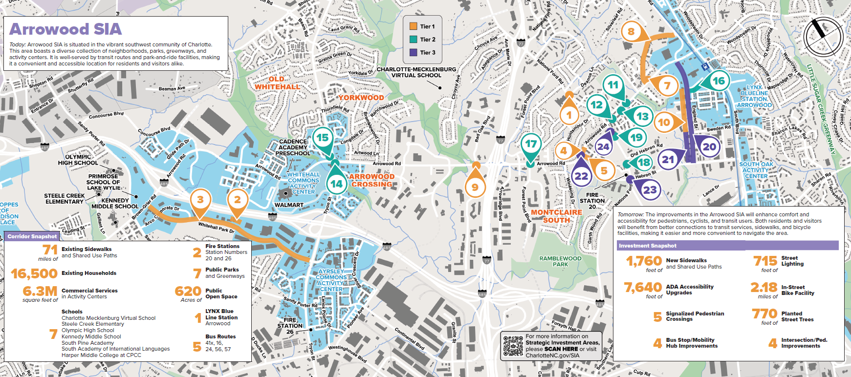
Arrowood SIA Projects

Slide 15
SAVE THE DATE
September 25th: Arrowood SIA Community Event

Slide 16
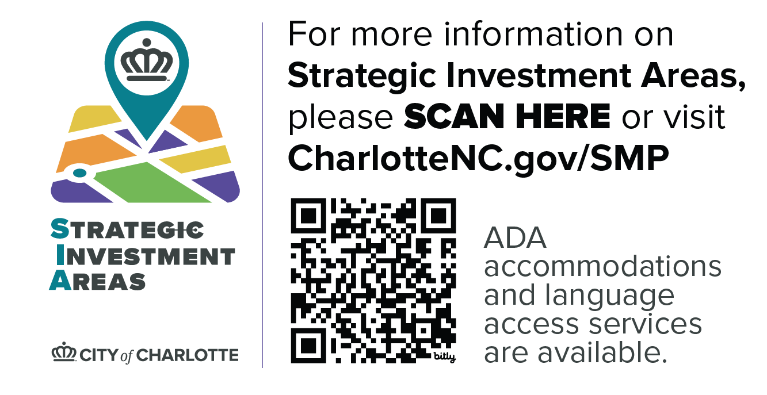
Where can you learn more about SIA?

Slide 17
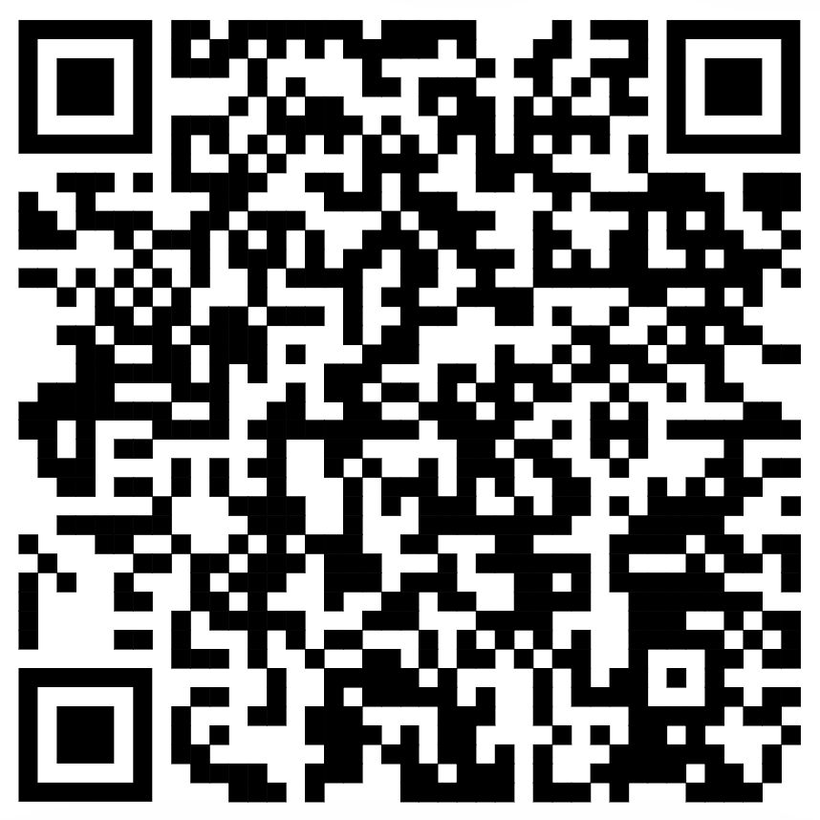
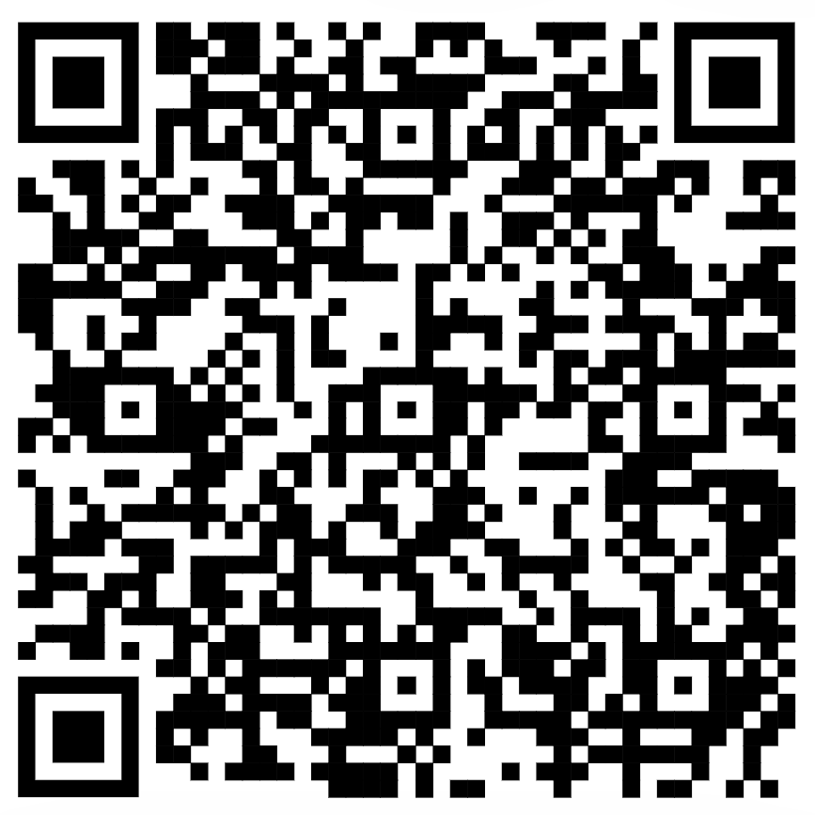
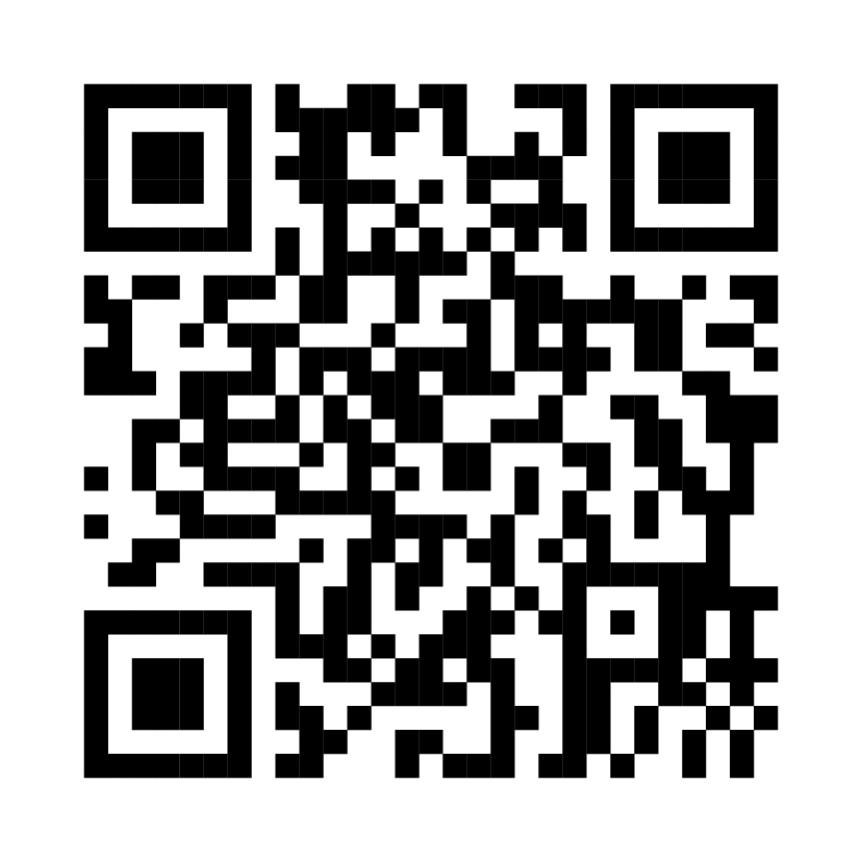
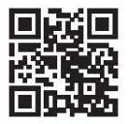
For More Information
For more information on Rail Corridors
For more information on Better Bus
For more information on Microtransit
For more information on Strategic Investment Areas
17

Slide 18
CATS Q&A
Public Safety
Bus Stop Inventory & Upgrades
Archdale Light Rail Station

Slide 19
Public Safety
What measures are in place to ensure safety and security at bus stops and transit stations?
CATS works in partnership with local law enforcement across our service area
CATS contracts with PSS for transit stations and transit centers for safety and security
CATS vehicles and facilities are equipped with cameras to monitor activity
How will the mobility plan invest in safe pedestrian access for stops?
CATS is evaluating locations of all bus stops to define pedestrian access and safety
CATS partners with local jurisdictions to install pedestrian crossings

Slide 20
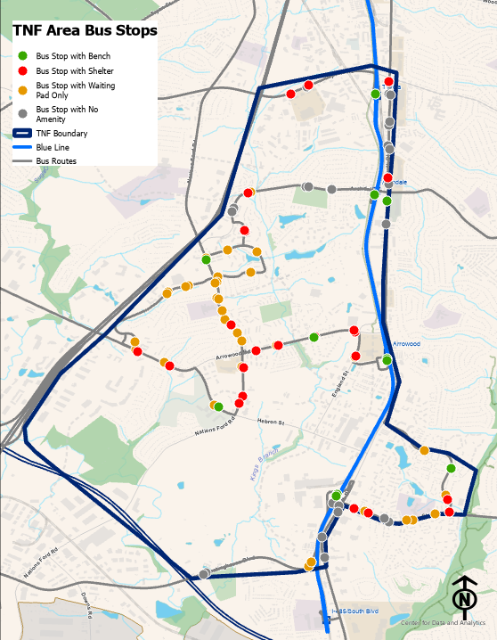
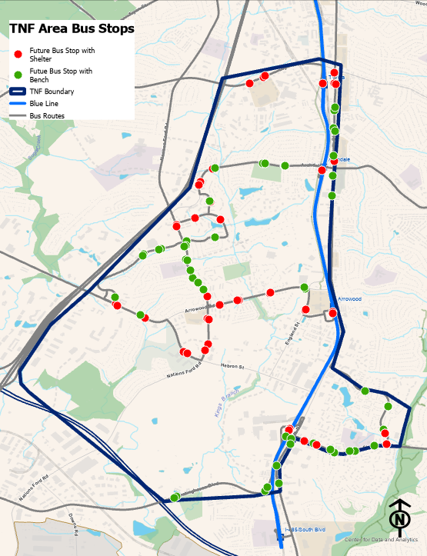
Bus Stop Inventory & Upgrades
What are current and planned bus stop improvements?
Current
Future
Waiting Pad | 34
Bench | 24
Shelter | 11
No Amenity | 24
Bench | 52
Shelter | 41

Slide 21
Archdale Light Rail Station
What is the status of the Archdale Blue Line Station Elevators?
  Customers are notified when elevators are out of service
  Complimentary connecting bus bridge service is provided when elevators are out of service
  Original Blue Line elevators are nearing end of useful life
  Elevator Modernization planning underway for original Blue Line (Uptown Charlotte –I 485/South Blvd)
  Timeline of improvement project dependent on available budget

