Slide 1
HOPWA
Pre-submittal Conference

Slide 2
What is HOPWA?
Housing Opportunities for Persons With AIDS (HOPWA) Program
Only Federal program dedicated to the housing needs of people living with HIV/AIDS.
Notes:
These are n

Slide 3
How do the funds flow down?
HUD
City of Charlotte (Grantee)
Carolinas CARE Partnership (Project Sponsor)
Sub-recipients

Slide 4
Client Eligibility
Individuals that are medically diagnosed with HIV/AIDS and their families; and
Eighty percent (80%) or below of Area Medium Income; and
Live in Anson, Cabarrus, Gaston, Iredell, Lincoln, Mecklenburg, Rowan and Union (NC) and Chester, Lancaster and York Counties (SC).

Slide 5
Eligible Activities
Supportive Services
Short-term Rent, Mortgage and Utility payment
Housing Information Services
Operational Expenses for Facility-Based Housing
Adult daycare and personal assistance
Alcohol and drug abuse services
Case management
Childcare and other child services
Education
Employment assistance and training
Legal Services
Life skills management
Meals/ nutritional services
Mental health services
Transportation
Outreach
Notes:
These are n

Slide 6
Contracting with Carolinas CARE Partnership (CCP)
CCP has contracting requirements.
Insurance
Detailed invoicing
Financial expectations
Funding is provided on a reimbursement basis.
Payments may take up to 60 days to process.
Notes:
Review budget form

Slide 7
Proposals
Use the checklist found on page 4 of the RFP.
For numbered forms, use provided formats.
For staffing, only provide staff directly related to the program/activity funded.
There are no limits on amount of funds requested.
Contracts usually do not cover the full cost of an activity.
Proposal must be a nonduplicated service.
Contracts are for one year.
Notes:
Review budget form

Slide 8
Changes from FY2023 RFP
New Questions
Question 2.2 – identify leveraging opportunities with HOPWA funds to provide or compliment additional services and/or housing resources
Question 4.5 & 4.6 – identity activities to be included in Administrative and Program Delivery budget request
Question 5.4 –unduplicated clients separated from budget
Note: These are not the only new questions and the numbering and or wording of last years questions may have changed.

Slide 9
Changes from FY2023 RFP (cont’d)
RFP Application Scorecard
Funding review committee members will utilize this document to review all applications submitted.
Billing Reimbursement
Agencies will be reimbursed for Actual Cost of Providing Eligible HOPWA Activity. Versus prior unit billing for some selected supportive service.
Revised Proposed Service Budget (Form 5)
Added line items for all eligible activities with separate tab to calculate operational expenses for Facility Based Housing
Program Delivery & Administrative cost now eligible.
Agencies will be reimbursed for Actual Cost of providing the Eligible HOPWA Activity selected on the Proposed Service Budget (Form 5).

Slide 10
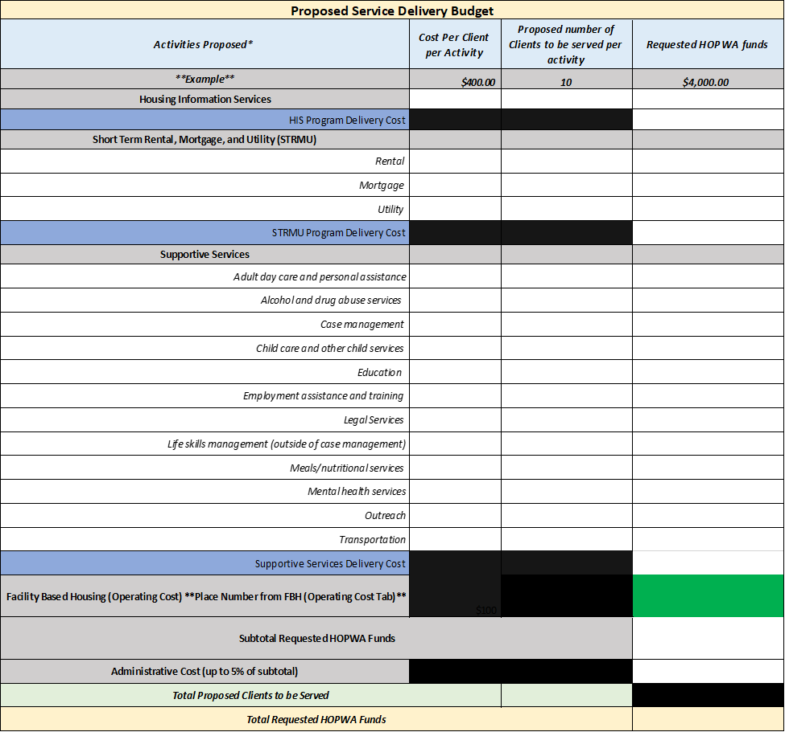
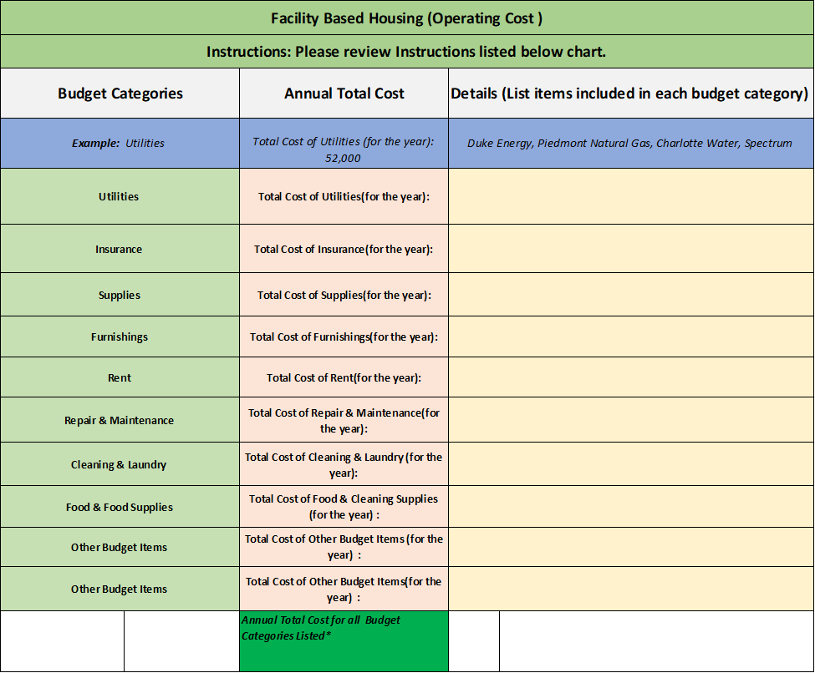
(Form 5) Proposed Service Budget
Proposed Service Delivery Budget
Facility Based Housing (Operating Cost)

Slide 11
How Proposals Will Be Evaluated
Qualifications and experience
Proposed approach
Proposed cost effectiveness
Availability to complete program work in a timely manner
Reference HOPWA RFP Application Scorecard

Slide 12
Timeline
April 19, 2023 – RFP conference
May 03, 2023 – deadline for questions
May 17, 2023 – 11:59pm submittal
Email questions to akeem.mcduffie@charlottenc.gov
An addendum will be posted answering submitted questions
Submit a pdf of proposal via email
Akeem McDuffie
akeem.mcduffie@charlottenc.gov

Slide 13
Questions email to: akeem.mcduffie@charlottenc.gov

