Slide 1
Collective Storm Drainage Improvement Project Z
Pre-Bid - Webex
JUNE 13, 2023 @ 2:00 PM

Slide 2
What is Charlotte Business INClusion?
In 2013 the Charlotte City Council adopted the Charlotte Business INClusion (CBI) Policy to promote diversity, inclusion, and local business opportunities for Minority, Women, and Small Business Enterprises (MWSBEs) headquartered in the Charlotte Combined Statistical Area.
The CBI Policy replaces the Small Business Opportunity (SBO) Policy.
The CBI Policy expands the geographic area for SBE certification eligibility. Firms with an office in any of the following Counties are now eligible for SBE certification and M/WBE registration:
North Carolina: Anson, Cabarrus, Cleveland, Gaston, Iredell, Lincoln, Mecklenburg, Rowan, Stanly, and Union
South Carolina: Chester, Lancaster, and York
Please refer eligible M/W/SBEs that you use and/or know!

Slide 3
Subcontracting Goals for this Project
This project has two Subcontracting Goals:
7% MBE Goal
16% SBE Goal
Per the Charlotte Business INClusion (CBI) Policy, Bidders must meet both the 7% MBE and 16% SBE Goals or comply with the GFE and Good Faith Negotiation requirements and earn a minimum of 50 GFE points for the unmet goal.
Bidders will receive credit toward the 7% MBE and 16% SBE Goals for City of Charlotte registered MBEs and certified SBEs that are listed on the CBI Form 3.
The CBI Form 3 must be submitted with your bid. Failure to submit CBI Form 3 will constitute grounds for rejection of your bid.
If one of the goals is not met at time of bid, the City will give Bidders credit toward meeting the unmet goal for City of Charlotte MBEs and SBEs submitted within 24 hours of the Bid Opening.

Slide 4
City Identified Subcontracting Opportunities
The following table list potential SBE and MBE subcontracting opportunities identified by the City. This is a potential listing, not all inclusive, Bidders may identify additional or different opportunities:
NIGP Code | Description
91244 | Excavation
91319 | Construction, Curb and Gutter (Includes Maintenance, Repair, and Removal)
91345 | Construction, Sewer and Storm Drain
91347 | Construction, Sidewalk and Driveway (Includes Pedestrian and Handicap Ramps)
91395 | Paving/Resurfacing
91455 | Masonry
96239 | Hauling Services
96291 | Utility Locator Service (Underground)
96884 | Traffic Control Services (To Include Placement and Removal of Control Devices)
98814 | Erosion Control Services

Slide 5
On the CBI Form 3
City will count SBE and MBE commitments listed on CBI Form 3 for all tier levels.
The City will give Bidders credit toward meeting the subcontracting goal for City of Charlotte MSBEs submitted within 24 hours of the Bid Opening.
Expenditures for materials, supplies, and equipment will count for only 60% toward the SBE and MBE Goal. Bidders should only document this 60% on CBI Form 3.
When listing SBE and MBE Commitments note that hauling has been separated out from all other scopes to allow flexibility in how Primes identify SBE and MBE hauling commitments. When identifying SBE and MBE for hauling services:
Do not list individual commitments to SBE and MBE but rather, identify each SBE and MBE hauler and the total lump sum projected utilization for hauling as a total scope.
List only the fees or commissions charged by the SBE and MBE.
The cost of materials and supplies will not count as part of the Hauler’s fees or commissions.
Bidders are highly encouraged to identify multiple haulers on CBI Form 3 to avoid non-compliance with the CBI Policy.

Slide 6
Good Faith Efforts (GFEs)
CBI Policy includes ten (10) GFE categories.
Minimum GFE Points required is 50.
Review of GFEs is both qualitative and quantitative.
The City no longer sets a minimum number of MBE and SBE contacts Bidders must make to earn GFE Points for the GFE Contacts Category.
Bidders are responsible for documenting to the City’s satisfaction that the Bidder contacted MBE and SBE in a manner reasonably calculated to meet the MBE and SBE Goal established for the Contract.
Bidders are highly encouraged to cast a wide net for MBE and SBE contacts across multiple subcontracting areas.

Slide 7
Good Faith Efforts (GFEs)
Bidders are highly encouraged to actively and aggressively work towards meeting the SBE and MBE subcontracting goal.
In an effort to help Bidders successfully meet the SBE and MBE goal, the City has identified ten (10) measures, referred to as GFEs, that Primes are encouraged to perform prior to bid opening.
If after negotiating in good faith a bidder is not able to meet the established SBE and MBE subcontracting goal, Bidder’s will be required to submit all GFE supporting documentation.
Failure to meet the SBE and MBE Goal and the Good Faith Efforts will constitute grounds for rejection of your bid.
All actions necessary to earn GFEs
must be performed prior to bid opening.

Slide 8
Most commonly claimed GFEs
***Please read the GFE descriptions on how to meet each GFE carefully and note that all actions necessary to earn the GFE points must be done prior to the Bid Opening.***
To receive credit:
5.3.1: Contacts. Perform A –G.
*5.3.2: Making Plans Available. List in your solicitation, submitted to SBE and MBE at least 10 days prior to the Bid Opening, the availability of the plans and specs and the location or method of free accessibility.
*5.3.3: Breaking Down Work. The scope of work to be broken down or combined to facilitate SBE and MBE participation must be stated in your solicitation; simply listing scopes of work in your solicitation is not sufficient and will not be given credit.
5.3.4: Working with SBE and MBE Assistance Organizations. The four CBI-approved organizations are listed in Section 3.3 in the CBI Section of the spec book.
5.3.7: Negotiating in Good Faith with SBE and MBEs. Documentation showing back and forth dialogue will be requested.
*5.3.10: – Quick Pay Agreements on the Construction Contract Up For Award. State in your solicitation sent to each MBE and SBE the following “Quick Pay Commitment”:
________________ (your company name) agrees to provide quick pay to the Minority and Small Business Enterprise (SBE, MBE, WBE) contractors and suppliers in connection with the Contract to meet cash-flow demands for the project referenced herein. The term “quick pay” means a commitment to pay all SBE and MBEs participating in the Contract within twenty (20) days after confirmation that performance has been properly completed.
*A bidder may receive credit for these GFEs only if it receives credit for GFE 5.3.1.

Slide 9
Quick Pay Policy Sample
Quick Pay Policy
For
Project Number: ________________________
Project Name:__________________________________
Project Owner Name: CHARLOTTE WATER
________________ (your company name) agrees to provide quick pay to the Minority and Small Business Enterprise (SBE and MBE) contractors and suppliers in connection with the Contract to meet cash-flow demands for the project referenced herein. The term “quick pay” means a commitment to pay all MBEs and SBEs participating in the Contract within twenty (20) days after confirmation that performance has been properly completed.
This POLICY for QUICK PAY is hereby adopted by ________________________ (your company name) for the project referenced herein this ___________ day of __________________, 20____.
________________________
CONTRACTOR NAME
________________________
STREET ADDRESS
________________________
CITY, STATE, ZIP
________________________
PHONE NUMBER
________________________
SIGNATURE
Subscribed and Sworn before me
this ____ day of __________________, 20____
__________________________________
Signature
My commission expires ________________________

Slide 10
Factors when awarding GFEs
When deciding to award points for GFE Categories the City will consider among other factors:
Whether the bidder’s efforts were those of someone who was actively and aggressively working to meet the SBE and MBE Goals.
The Bidder’s past performance in meeting subcontracting goals on previous City projects.
The performance of other Bidders in meeting the subcontracting goal for the project up for award.

Slide 11
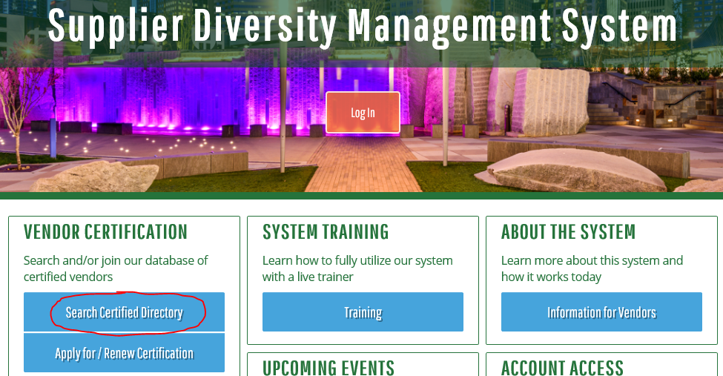
Where to find MBE and SBEs?
Search for CBI Certified Vendors in the City’s Contract Compliance system, B2GNow aka InclusionCLT:
https://charlotte.diversitycompliance.com
Click on “Search Certified Directory”
A spreadsheet of City of Charlotte certified MBE and SBEs can be found at:
www.charlottebusinessinclusion.com
Click on spreadsheet “Certified MWSBE List” then pick the tab.

Slide 12
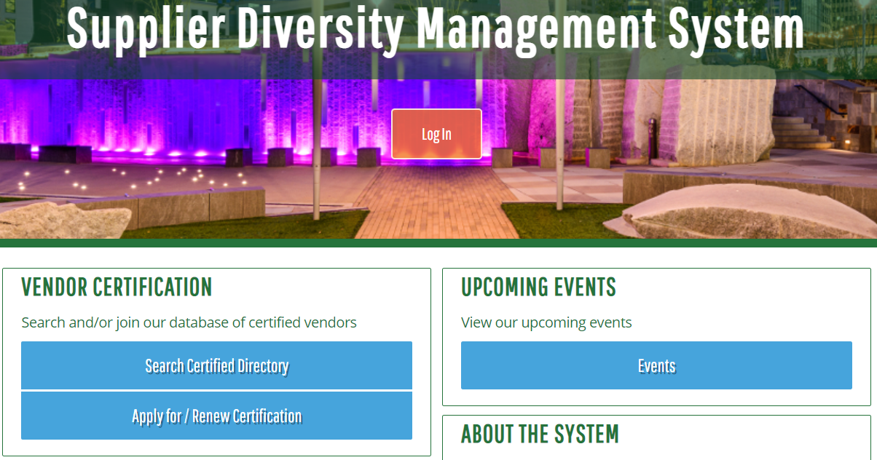
Prime and MBE/SBE roles in B2GNow aka InclusionCLT
The Prime MUST add and enter payments to MBEs/SBEs subs used on the project into B2Now aka INClusionCLT.
MBE/SBE subs MUST confirm/deny the payment entered by the Prime.
https://charlotte.diversitycompliance.com/

Slide 13
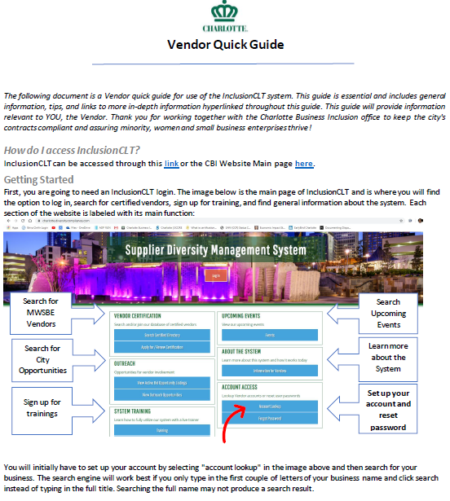
B2GNow/INClusionCLT Vendor Quick Guide

Slide 14
CBI Form Requirements
Form | FYI | Submission Requirements
CBI Form 1: Intent to Perform Contract with Own Workforce | Bidders must document capacity to perform 100% of the work. | Must be submitted at Bid Opening with all Supporting Documentation.
CBI Form 2: Solicitation Form | Bidder must document contacts no less than ten (10) days prior to Bid Opening. | Submitted within 3 Business Days after requested by the City.
CBI Form 2A: Good Faith Negotiation Form | Bidder must document each scope of work bid by an SBE and MBE but not selected by the Bidder to participate on the project. | Submitted within 3 Business Days after requested by the City.
CBI Form 3: Subcontractor/ Supplier Utilization Commitment | City will count all tiers of SBE and MBE participation identified on CBI Form 3 towards the established SBE and MBE Goal. SBE and MBE hauling services commitments must be listed in the hauling services section as a cumulative total scope amount. | Must be submitted at Bid Opening. The City will give Bidders credit toward meeting the Subcontracting Goals for those MSBEs submitted within twenty-four (24) hours of the Bid Opening.

Slide 15
CBI Form Requirements
Form | FYI | Submission Requirements
CBI Form 3A: Subcontractor/ Supplier Utilization Commitment-Alternates | To be utilized in the event Alternates are selected by the City. The SBE and MBE Goal will apply to the Total Contract Amount, including contingency and the selected Alternates. | Submitted within 3 Business Days after requested by the City.
CBI Form 4: Letter of Intent | Signature line(s) for utilizing SBE and MBE tiers has been added to form. | Submitted within 3 Business Days after requested by the City.
CBI Form 5: Good Faith Effort (GFE) and Statement of GFE Compliance | Ten (10) GFE categories. No minimum number of SBE and MBE contacts set by the City. Minimum GFE Points required is 50. | Submitted within 3 Business Days after requested by the City.
CBI Form 6: Payment Affidavit -Subcontractor/ Supplier Utilization | Bidders must identify all subcontractors and suppliers for all tiers. | Must be submitted to the City with each pay request for the duration of the Project. For Final Payment period, check the box indicating “Final Payment.”

Slide 16
Resources
The CBI Policy is available at:
www.charlottebusinessinclusion.com
Please refer any questions about the
Charlotte Business INClusion requirements
for this project to:
Cor’Deija Horne
704-353-1907/cor’deija.horne@charlottenc.gov

